Slide 1

Data-Driven Credit Risk Analysis & Loan Default Prediction
Understanding customer credit behavior using multi-table financial and behavioral data.
Presented By: Abhishek Kumar Pandey

Slide 2


Chandra Mouli Kotta Kota
Chandra Mouli Kotta Kota is a former Business Consultant/Data Scientist and has worked with prestigious companies like McKinsey, Citigroup(E-serve), Genpact in the past 19+ years. He has worked for clients across the globe and is an expert in Business and Big Data Analytics.
Professional Experience
- Worked on Marketing Analytics(CSI, CLM & Pricing), Risk Analytics(Credit Risk), Operation Analytics, and Digital Analytics with a focus on Retail/E-Commerce, Banking, Insurance, Telecom, and Media clients in Asia, Australia, Europe, and the US
- Hands on experience in development of Marketing & CRM Models (Acquisition, LTV Models, Cross Sell & Upsell, Attrition and MROI, Price and Promotion Models), Pricing Models(price & promo) and Risk Models (PD, LGD, EAD Models for Credit Cards, Consumer Loans and Insurance Portfolios)
- Hands-on expertise in Big data and Multivariate analytical techniques, including classical & machine learning algorithms, including regression, instance-based, regularization, Decision tree, Bayesian, clustering, Association rules, ANN, Deep learning, Generative AI, and Ensemble algorithms
- Have used different statistical flat forms like SAS/SAS EM, R, Python, SPSS, SPSS Modeler, Hadoop, Spark, Tableau, Matlab, Julia, Salesforce, SQL, Excel, VBA, PowerBI, Cloud Platforms (AWS, GCP), MongoDB, Hbase.
- Trained and coached several client teams and various individuals on advanced analytics, Big data analytics tools and techniques as part of capability building programs
- Chandra Name is Featured as
- Top 10 data scientists (2015) in India by Analytics India Magazine (https://www.analyticsindiamag.com/top-10-data-scientists-in-india-2015/)
- Featured as expert in Data Analytics & AI by whoknowsabout.com (https://whoknowsabout.com/blogpage/hidden-gems-boutiques-and-independent-consultants.html)
Chief Data Scientist
Areas of Expertise:
Big Data Analytics
Business Analytics
Machine Learning
Deep Learning
Marketing Analytics
Risk Analytics
Operation Analytics
Digital Analytics
Business Intelligence
Artificial Intelligence
Academic Credentials
Master of Science(Mathematics/Statistics): IIT-Madras, Chennai

Slide 3
Business Context
Why Credit Risk Analysis Matters
Financial institutions must evaluate whether a customer is capable of repaying a loan before approval.
Incorrect risk assessment can lead to:
High loan default rates
Financial losses
Increased NPAs (Non-Performing Assets)
Poor customer targeting
Rejection of eligible customers
With increasing customer data availability, organizations require data-driven systems to improve credit approval decisions
. Business Impact
Reduce loan defaults
Improve approval quality
Identify risky applicants early
Increase profitability
Improve customer retention

Slide 4
Problem Statement
Business Problem
The objective of this project is to analyze customer financial, behavioral, and historical credit data to understand factors influencing loan default.
The dataset contains multiple relational tables capturing:
Customer demographics
Credit bureau records
Previous loan applications
Installment payment behavior
Credit card spending behavior
POS cash loan behavior
Analytical Goals
EDA Perspective
Identify risk patterns
Analyze repayment behavior
Detect financial instability indicators
Understand customer segments
ML Perspective
Predict whether a customer will default
Improve risk classification
Create meaningful engineered features

Slide 5
Business Objectives
Project Objectives
Primary Objectives
Understand customer credit behaviour
Analyze repayment and default patterns
Identify high-risk customer segments
Perform customer-level feature engineering
Build analytical foundation for ML model development
Expected Outcomes
Better risk assessment
Improved loan approval strategy
Data-driven lending decisions
Reduced financial losses

Slide 6
Tools & Technologies
Category | Tools
Programming | Python
Data Manipulation | Pandas, NumPy
Visualization | Matplotlib, Seaborn, Plotly
Machine Learning | Scikit- Learn, XGBoost, LightGBM
Deployment (Future Scope) | Streamlit
Notebook Environment | Jupyter Notebook
Version Control | Git/ GitHub
Dashboarding | Power BI, Streamlit

Slide 7
Dataset Overview
Home Credit Default Risk Dataset
Dataset Characteristics
~300K+ customer records
7 interconnected tables
Multi-source financial data
Combination of static + behavioral data
Real-world credit risk dataset
Central Dataset
application_train
Contains:
Customer demographics
Income details
Loan information
Default target variable
Target Variable
TARGET = 1 → Default
TARGET = 0 → Non-default

Slide 8
All Dataset Tables Summary
Table | Rows | Columns | Numeric Cols | Categorical Cols | Avg Missing %
application_train | 3,07,511 | 122 | 106 | 16 | 24.4
bureau | 17,16,428 | 17 | 14 | 3 | 13.5
bureau_balance | 2,72,99,925 | 3 | 2 | 1 | 0
previous_application | 16,70,214 | 37 | 21 | 16 | 17.98
POS_CASH_balance | 1,00,01,358 | 8 | 7 | 1 | 0.07
credit_card_balance | 38,40,312 | 23 | 22 | 1 | 6.65
installments_payments | 1,36,05,401 | 8 | 8 | 0 | 0.01
Observations:
application_train is the main table — 307,511 rows, 122 columns. Rich but messy (lots of missing values).
installments_payments and POS_CASH_balance are the largest auxiliary tables with millions of rows each.
bureau and previous_application are multi-row-per-client and need aggregation before joining.
installments_payments has zero missing values — the cleanest table in the set.

Slide 9
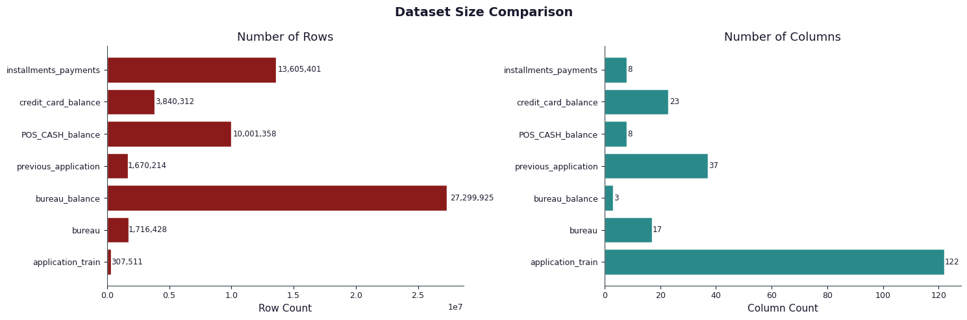
Dataset Size Comparison

Slide 10
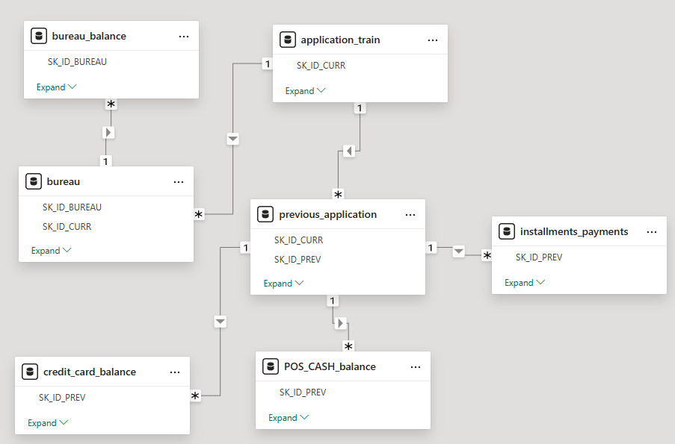
Data Architecture / ER Diagram

Slide 11
Data Dictionary

Slide 12
Data Dictionary (Main Table)
Application Dataset Overview
Feature | Description | Type
SK_ID_CURR | Customer ID | ID
TARGET | Default Flag | Target
AMT_INCOME_TOTAL | Customer Income | Numeric
AMT_CREDIT | Loan Amount | Numeric
AMT_ANNUITY | Loan Installment | Numeric
NAME_CONTRACT_TYPE | Loan Type | Categorical
CODE_GENDER | Gender | Categorical
DAYS_BIRTH | Customer Age | Numeric
DAYS_EMPLOYED | Employment Duration | Numeric
OCCUPATION_TYPE | Occupation | Categorical

Slide 13
Data Dictionary (Auxiliary Tables)
1. Bureau Table
External Credit History : Shape: (1716428, 17)
Feature | Description | Type | Business Meaning
SK_ID_CURR | Customer ID | Key | Links to application table
SK_ID_BUREAU | Bureau Loan ID | ID | Unique external credit record
CREDIT_ACTIVE | Loan Status | Categorical | Active/ Closed/ Sold credit
CREDIT_CURRENCY | Currency type | Numeric | Loan Age
CREDIT_AGE_OVERDUE | Days overdue | Numeric | Delayed repayment indicator
DAYS_CREDIT_ENDDATE | Remaining days to end loan | Numeric | Expected loan closure
DAYS_ENDDATE_FACT | Actual loan closure date | Numeric | Real Closure timeline
AMT_CREDIT_MAX_OVERDUE | Maximum overdue amount | Numeric | Worst overdue history
CNT_CREDIT_PROLONG | Loan prolongation count | Numeric | Loan extension frequency
AMT_CREDIT_SUM | Total credit amount | Numeric | Total borrowed amount
AMT_CREDIT_SUM_DEB | Outstanding debt | Numeric | Current unpaid debt
AMT_CREDIT_SUM_LIMIT | Credit limit | Numeric | Available credit limit
AMT_CREDIT_SUM_OVERDUE | Overdue amount | Numeric | Pending overdue balance
CREDIT_TYPE | Credit category | Categorical | Consumer loan, credit card etc
DAYS_CREDIT_UPDATE | Days since bureau update | Numeric | Data recency
AMT_ANNUITY | Loan annuity amount | Numeric | Recurring installment

Slide 14
Data Dictionary (Auxiliary Tables)
2. Bureau Balance Table
Monthly Credit Status: Shape: (27299925, 3)
Feature | Description | Type | Business Meaning
SK_ID_BUREAU | Bureau loan ID | Key | Connects to table
MONTHS_BALANCE | Monthly timeline | Numeric | Historical month index
STATUS | Monthly loan status | Categorical | Payment/ default condition
STATUS Meaning
Status | Meaning | Status | Meaning
C | Closed | 2 | 31-60 days overdue
X | No loan for month | 3 | 61-90 days overdue
0 | No overdue | 4 | 91-120 days overdue
1 | 1-30 days overdue | 5 | 120+ days overdue

Slide 15
Data Dictionary (Auxiliary Tables)
3. Previous Application Table
Historical Loan Applications: Shape: (1670214, 37)
Feature | Description | Type | Business Meaning
SK_ID_PREV | Previous Loan ID | ID | Unique previous application
SK_ID_CURR | Customer_id | Key | Links to customer
NAME_CONTRACT_TYPE | Loan Type | Categorical | Cash/ Consumer loan
AMT_ANNUITY | Installment amount | Numeric | EMI amount
AMT_APPLICATION | Applied amount | Numeric | Request amount
AMT_CREDIT | Approved credit | Numeric | Approved amount
AMT_DOWN_PAYMENT | Down payment | Numeric | Initial payment
AMT_GOODS_PRICE | Goods price | Numeric | Financial goods value
WEEKDAY_APPR_PROCESS_START | Application weekday | Categorical | Day applied
HOUR_APPR_PROCESS_START | Application hour | Numeric | Application timing
FLAG_LAST_APPL_PER_CONTRACT | Last application flag | Binary | Latest application indicator
NFLAG_LAST_APPL_IN_DAY | Applications per day | Numeric | Multiple applications indicator
RATE_DOWN_PAYMENT | Down payment ratio | Numeric | Down payment percentage
RATE_INTEREST_PRIMARY | Primary interest rate | Numeric | Interest rate
RATE_INTEREST_PRIVILEGED | Privileged interest rate | Numeric | Discounted rate
NAME_CASH_LOAN_PURPOSE | Loan purpose | Categorical | Repair, business etc.

Slide 16
Data Dictionary (Auxiliary Tables)
4. Instalments Payments Table
Repayment Behaviour: Shape: (13605401, 8)
Feature | Description | Type | Business Meaning
SK_ID_PREV | Previous loan ID | Key | Loan reference
SK_ID_CURR | Customer ID | Key | Customer reference
NUM_INSTALMENT_VERSION | Installment version | Numeric | Modified installment plan
NUM_INSTALMENT_NUMBER | Installment sequence | Numeric | EMI number
DAYS_INSTALMENT | Scheduled payment | Numeric | Due date
DAYS_ENTRY_PAYMENT | Actual payment day | Numeric | Actual payment timing
AMT_INSTALMENT | Installment amount | Numeric | Expected EMI
AMT_PAYMENT | Amount paid | Numeric | Actual payment
Important Derived Metrics
Metric | Formula | Meaning
Payment Delay | DAYS_ENTRY_PAYMENT – DAYS_INSTALMENT | Late payment days
Payment Difference | AMT_PAYMENT – AMT_INSTALMENT | Under/ over payment

Slide 17
Data Dictionary (Auxiliary Tables)
5. Credit Card Balance Table
Credit Card Spending Behaviour : Shape: (3840312, 23)
Feature | Description | Type
SK_ID_PREV | Previous credit card ID | ID
SK_ID_CURR | Customer ID | Key
MONTHS_BALANCE | Historical month | Numeric
AMT_BALANCE | Current balance | Numeric
AMT_CREDIT_LIMIT_ACTUAL | Credit limit | Numeric
AMT_DRAWINGS_ATM_CURRENT | ATM withdrawal amount | Numeric
AMT_DRAWINGS_OTHER_CURRENT | Other spending | Numeric
AMT_DRAWINGS_POS_CURRENT | POS spending | Numeric
AMT_INST_MIN_REGULARITY | Minimum due payment | Numeric
AMT_PAYMENT_CURRENT | Current payment | Numeric
AMT_PAYMENT_TOTAL_CURRENT | Total payment | Numeric
AMT_RECEIVABLE_PRINCIPAL | Principal receivable | Numeric
AMT_RECIVABLE | Total receivable | Numeric
AMT_TOTAL_RECEIVABLE | Outstanding receivable | Numeric
CNT_DRAWINGS_ATM_CURRENT | ATM withdrawal count | Numeric
CNT_DRAWINGS_CURRENT | Total drawing count | Numeric

Slide 18
Data Dictionary (Auxiliary Tables)
6. POS_CASH_balance Table
Point of Sale & Cash Loan Behaviour: Shape: (10001358, 8)
Feature | Description | Type
SK_ID_PREV | Previous loan ID | ID
SK_ID_CURR | Customer ID | Key
MONTHS_BALANCE | Historical month index | Numeric
CNT_INSTALMENT | Total installments | Numeric
CNT_INSTALMENT_FUTURE | Remaining installments | Numeric
NAME_CONTRACT_STATUS | Loan status | Categorical
SK_DPD | Days past due | Numeric
SK_DPD_DEF | Days past due with tolerance | Numeric

Slide 19
Dataset Structure Summary

Slide 20
Dataset Structural Assessment
Dataset | Rows | Columns | Description
application_train | 307K | 122 | Main customer dataset
Bureau | 1.7M | 17 | External credit history
bureau_balance | 27M | 3 | Monthly bureau status
previous_application | 1.6M | 37 | Historical applications
installments_payments | 13.6M | 8 | Payment history
credti_card_balance | 3.8M | 23 | Credit behavior
POS_CASH_balance | 10M | 8 | POS & cash loans
Key Observation
“The project involves large-scale multi-table relational financial data requiring aggregation and customer-level integration.”

Slide 21
Data Auditing

Slide 22
Application_train/ tests

Slide 23
Missing Value Assessment — Application Dataset
Summary Statement
The application_train dataset contains several high-missingness features primarily related to housing and property information. Most missing values appear to be business-contextual rather than structural data quality issues.
S.No | Column Name | Column Purpose | Missing % / Anomaly | What We Did | Why We Did It
1 | COMMONAREA_AVG | Common building area | 69.87% | Drop Medi and Mod And out of avg create a flag and then drop avg too | Too much missing value, and too preserve the info.
2 | COMMONAREA_MEDI | Median common building area | 69.87%
3 | COMMONAREA_MODE | Mode common building area | 69.87%
4 | NONLIVINGAPARTMENTS_AVG | Non-living apartment area | 69.43%
5 | NONLIVINGAPARTMENTS_MEDI | Median non-living apartment area | 69.43%
6 | NONLIVINGAPARTMENTS_MODE | Mode non-living apartment area | 69.43%
7 | FONDKAPREMONT_MODE | Building repair fund type | 68.38%
8 | LIVINGAPARTMENTS_AVG | Living apartment area | 68.35%
9 | COMMONAREA_AVG | Common building area | 69.87%
10 | LIVINGAPARTMENTS_MEDI | Median living apartment area | 68.35%
11 | LIVINGAPARTMENTS_MODE | Mode living apartment area | 68.35%

Slide 24
Missing Value Assessment — Application Dataset
S.No | Column Name | Column Purpose | Missing % / Anomaly | What We Did | Why We Did It
12 | FLOORSMIN_AVG | Minimum floors in building | 67.84% | Drop Medi and Mod And out of avg create a flag and then drop avg too | Too much missing value, and too preserve the info.
13 | FLOORSMIN_MEDI | Median minimum floors | 67.84%
14 | FLOORSMIN_MODE | Mode minimum floors | 67.84%
15 | YEARS_BUILD_AVG | Building construction year | 66.49%
16 | YEARS_BUILD_MEDI | Median building year | 66.49%
17 | YEARS_BUILD_MODE | Mode building year | 66.49%
18 | OWN_CAR_AGE | Customer car age | 65.99%
19 | LANDAREA_AVG | Land area | 59.37%
20 | LANDAREA_MEDI | Median land area | 59.37%
21 | LANDAREA_MODE | Mode land area | 59.37%
22 | BASEMENTAREA_AVG | Basement area | 58.51%
23 | BASEMENTAREA_MEDI | Median basement area | 58.51%
24 | BASEMENTAREA_MODE | Mode basement area | 58.51%
25 | NONLIVINGAREA_AVG | Non-living area | 55.17%
26 | NONLIVINGAREA_MEDI | Median non-living area | 55.17%
27 | NONLIVINGAREA_MODE | Mode non-living area | 55.17%

Slide 25
Missing Value Assessment — Application Dataset
S.No | Column Name | Column Purpose | Missing % / Anomaly | What We Did | Why We Did It
28 | ELEVATORS_AVG | Elevator information | 53.29% | Drop Medi and Mod And out of avg create a flag and then drop avg too | Too much missing value, and too preserve the info.
29 | ELEVATORS_MEDI | Median elevator information | 53.29%
30 | ELEVATORS_MODE | Mode elevator information | 53.29%
31 | APARTMENTS_AVG | Apartment area | 50.74%
32 | APARTMENTS_MEDI | Median apartment area | 50.74%
33 | APARTMENTS_MODE | Mode apartment area | 50.74%
34 | ENTRANCES_AVG | Building entrances | 50.34%
35 | ENTRANCES_MEDI | Median entrances | 50.34%
36 | ENTRANCES_MODE | Mode entrances | 50.34%
37 | LIVINGAREA_AVG | Living area | 50.19%
38 | LIVINGAREA_MEDI | Median living area | 50.19%
39 | LIVINGAREA_MODE | Mode living area | 50.19%
40 | HOUSETYPE_MODE | Housing type | 50.17%
41 | FLOORSMAX_AVG | Maximum floors | 49.76%
42 | FLOORSMAX_MODE | Mode maximum floors | 49.76%
43 | FLOORSMAX_MEDI | Median maximum floors | 49.76%

Slide 26
Missing Value Assessment — Application Dataset
S.No | Column Name | Column Purpose | Missing % / Anomaly | What We Did | Why We Did It
44 | TOTALAREA_MODE | Total apartment area | 48.26% | Use the information in creating flag | To preserve the message
45 | WALLSMATERIAL_MODE | Wall material type | 50.84% | Filled with Unknown | Preserve category information
46 | YEARS_BEGINEXPLUATATION_AVG | Building usage start year | 48.78% | Create flag and then drop | To preserve the message
47 | YEARS_BEGINEXPLUATATION_MEDI | Median usage year | 48.78% | Dropped | Duplicate of AVG/MODE feature
48 | YEARS_BEGINEXPLUATATION_MODE | Mode usage year | 48.78% | Dropped | Duplicate of AVG/MODE feature
49 | EMERGENCYSTATE_MODE | Emergency state | 47.39% | create a flag/drop it | If yes or missing then default rate is 9%
50 | OCCUPATION_TYPE | Customer occupation | 31.34% | Filled with Unknown | Missing occupation type
51 | AMT_REQ_CREDIT_BUREAU_HOUR | Bureau inquiry count/hour | 13.50% | 0 fill | No inquiry
52 | AMT_REQ_CREDIT_BUREAU_DAY | Bureau inquiry count/day | 13.50% | 0 fill | No inquiry
53 | AMT_REQ_CREDIT_BUREAU_WEEK | Bureau inquiry count/week | 13.50% | 0 fill | No inquiry
54 | AMT_REQ_CREDIT_BUREAU_MON | Bureau inquiry count/month | 13.50% | 0 fill | No inquiry
55 | AMT_REQ_CREDIT_BUREAU_QRT | Bureau inquiry count/quarter | 13.50% | 0 fill | No inquiry
56 | AMT_REQ_CREDIT_BUREAU_YEAR | Bureau inquiry count/year | 13.50% | 0 fill | No inquiry
57 | AMT_GOODS_PRICE | Goods price | 0.09% | Median fill | Very low missingness
58 | NAME_TYPE_SUITE | Accompanying persons | 0.42% | Fill with ‘Missing’ | Very low missingness
59 | DEF_30_CNT_SOCIAL_CIRCLE | 30-day default social circle | 0.33% | Fill 0 | Very low missingness
60 | AMT_ANNUITY | Loan annuity | 0.003% | Median fill | Negligible missingness

Slide 27
Missing Value Assessment — Application Dataset
S.No | Column Name | Column Purpose | Missing % / Anomaly | What We Did | Why We Did It
61 | DEF_60_CNT_SOCIAL_CIRCLE | 60-day default social circle | 0.33% | Fill 0 | Very low missingness
62 | OBS_30_CNT_SOCIAL_CIRCLE | 30-day observed social circle | 0.33% | Fill 0 | Very low missingness
63 | OBS_60_CNT_SOCIAL_CIRCLE | 60-day observed social circle | 0.33% | Fill 0 | Very low missingness
64 | EXT_SOURCE_2 | External risk score 2 | 0.21% | Creating a new column which contain mean of the three/ then 0.06% left then drop | To reduce missingness. And keep the crux of the three
65 | EXT_SOURCE_3 | External risk score 3 | 19.82%
66 | EXT_SOURCE_1 | External risk score 1 | 56.38%
67 | CNT_FAM_MEMBERS | Family member count | 0.0006% | Childern+2 if married else children +1 | Negligible missingness
68 | DAYS_LAST_PHONE_CHANGE | Days since last phone change | 0.0003% | Fill 0 | Negligible missingness
69 | DAYS_EMPLOYED | Employment days | Anomaly: 365243 | Converted anomaly to NaN | 365243 represented unrealistic employment duration
70 | CODE_GENDER | Customer gender | 0.000013% /Contains XNA | Dropped XNA rows | Invalid category/not available in test
71 | NAME_FAMILY_STATUS | Persons accompanying applicant | 0.42% missing + rare categories | Filled missing values and analysed rare categories separately and merged | Preserve business meaning while handling low-frequency categories
72 | ORGANIZATION_TYPE | Employer organization type | Contains XNA category | Replaced with Not Working | Business meaningful replacement for unemployed/non-working applicants (because it hold only pensioner and unemployed in NAME_INCOME_TYPE)

Slide 28
Previous_application

Slide 29
Missing Value Assessment (previous_application)
Summary Statement
The previous_application dataset contains several high-missingness variables associated with historical loan lifecycle events, interest-rate information, and down-payment details. Most missing values appear to be business-driven and linked to rejected or non-applicable loan applications.
S. No. | Column Name | Column Purpose | Missing % / Anomaly | What We Did | Why We Did It
1 | RATE_INTEREST_PRIVILEGED | Special/privileged interest rate | 99.64370% | Dropped | Almost completely missing
2 | RATE_INTEREST_PRIMARY | Primary interest rate | 99.64370% | Dropped | Almost completely missing
3 | AMT_DOWN_PAYMENT | Initial down payment amount | 53.63648% 2 negative amount | Create a flag/ Filled with 0 and negative to 0 | Missing values are much more common in : Cancelled, Refused
4 | RATE_DOWN_PAYMENT | Down payment ratio | 53.63648% | Flag / Filled with 0 | Same as above but stronger signal
5 | NAME_TYPE_SUITE | Persons accompanying applicant | 49.11975% | Filled with Unknown / mode | Preserve category consistency
6 | DAYS_LAST_DUE | Final due date | 40.29813% / 365243 | Filled with 0 + indicator | Missing linked with canceled / refused loans
7 | DAYS_FIRST_DRAWING | First drawing date | 40.29813%/ 96% after 365243 | dropped | Loan never activated
8 | DAYS_FIRST_DUE | First due date | 40.29813%/ 365243 | Filled with 0 + indicator | No repayment schedule available
9 | DAYS_TERMINATION | Loan termination date | 40.29813% / 365243 | Filled with 0 + indicator | Loan lifecycle incomplete
10 | NFLAG_INSURED_ON_APPROVAL | Insurance approval flag | 40.29813% | Filled with 0 | Missing mostly in cancelled /refused applications

Slide 30
Missing Value Assessment (previous_application)
S. No. | Column Name | Column Purpose | Missing % / Anomaly | What We Did | Why We Did It
11 | DAYS_LAST_DUE_1ST_VERSION | Initial last due date | 40.29813%/ 365243 | Filled with 0 + indicator | No finalized repayment schedule
12 | AMT_GOODS_PRICE | Goods financed price | 23.08177% | Create a flag/ fill with 0 | Show signals toward cash loan/ revolving loans And 0 already present so flag
13 | AMT_ANNUITY | Loan annuity amount | 22.28667% | Create a flag /fill to 0 | Almost every approved application has an annuity value.
14 | CNT_PAYMENT | Planned payment count | 22.28637% | Fill 0 | It is missing specially in approved and no real 0 present so no need of flag
15 | PRODUCT_COMBINATION | Loan-product combination | 0.02072% | Just drop missing rows | Too low missing
16 | AMT_CREDIT | Previous loan credit amount | 1 value | Drop | Negligible missingness

Slide 31
bureau

Slide 32
Missing Value Assessment (bureau)
Summary Statement
The bureau dataset contains external credit history information collected from credit bureaus. Missing values are primarily concentrated in overdue, debt, and loan closure-related variables, reflecting variations in customer credit activity and loan status.
S, No. | Column Name | Column Purpose | Missing % / Anomaly | What We Did | Why We Did It
1 | AMT_ANNUITY | Loan annuity amount | 71.47349% | Dropped | Missing is spread across all credit_active and credit_type
2 | AMT_CREDIT_MAX_OVERDUE | Maximum overdue credit amount | 65.51326% | Filled with 0/ flag of missing | Missing often indicates no overdue history
3 | DAYS_ENDDATE_FACT | Actual loan end date | 36.91696% | Filled with 0 + indicator | Missing often means loan still active
4 | AMT_CREDIT_SUM_LIMIT | Credit card limit amount | 34.47741% | Filled with 0 | Missing often indicates no credit limit
5 | AMT_CREDIT_SUM_DEBT | Current debt amount | 15.01193% | Filled with 0/ create a flag | It is missing in credit_active all category
6 | AMT_CREDIT_SUM_DEBT | Current debt amount | 0.49% Negative values | Create a flag and clip to 0 | Overpayment Data reporting issue.
7 | DAYS_CREDIT_ENDDATE | Expected loan end date | 6.14957% | Median fill | Moderate missingness
8 | AMT_CREDIT_SUM | actual credit amount | 0.0007% | Drop | Credit not be 0

Slide 33
credit_card_balance

Slide 34
Missing Value Assessment (credit_card_balance)
Summary Statement
The credit_card_balance dataset shows relatively low-to-moderate missingness concentrated in transaction and instalment-related variables. Missing values are primarily associated with inactive credit card usage or unavailable transaction activity.
S. No. | Feature | Missing | Feature Category | Business Interpretation | Suggested Treatment
1 | AMT_PAYMENT_CURRENT | Current payment amount | 19.99806% | Create flag/ Filled with 0 | Missing pattern differs from drawing variables and real 0 values exist.
2 | AMT_DRAWINGS_ATM_CURRENT | ATM withdrawal amount | 19.52487% | Create a flag and fill with 0 | Shares identical missingness pattern with all drawing amount/count variables. Create one DRAWING_INFO_MISSING flag and fill all with 0.
3 | CNT_DRAWINGS_ATM_CURRENT | ATM withdrawal count | 19.52487%
4 | AMT_DRAWINGS_OTHER_CURRENT | Other withdrawal amount | 19.52487%
5 | CNT_DRAWINGS_OTHER_CURRENT | Other withdrawal count | 19.52487%
6 | CNT_DRAWINGS_POS_CURRENT | POS transaction count | 19.52487%
7 | AMT_DRAWINGS_POS_CURRENT | POS withdrawal amount | 19.52487%
8 | AMT_INST_MIN_REGULARITY | Minimum regular installment amount | 7.94821% | Create a flag and fill with 0 | Identical missing
9 | CNT_INSTALMENT_MATURE_CUM | Completed installment count | 7.94821%

Slide 35
POS_CASH_balance

Slide 36
Missing Value Assessment (credit_card_balance)
Summary Statement
The POS_CASH_balance table was highly clean with only ~0.26% missing values.
Missing values existed only in:
CNT_INSTALMENT
CNT_INSTALMENT_FUTURE
These columns represent:
total instalment count
remaining future instalments
Since the missing percentage was extremely low, **median imputation** was applied.
This ensured:
minimal impact on distribution
preservation of dataset size
stable aggregation behaviour
No major anomalies or structural issues were identified in this table.
S. No. | Feature | Missing | Feature Category | Business Interpretation | Suggested Treatment
1 | CNT_INSTALMENT_FUTURE | Remaining future installments | 0.26083% | Drop | Already contain 0 and very low missingness
2 | CNT_INSTALMENT | Total instalment count | 0.26067% | Drop | Very low missingness with minimal impact

Slide 37
Installments_payments

Slide 38
Missing Value Assessment (credit_card_balance)
Summary Statement
Extremely low missingness (~0.02%)
Missing values found only in payment-related columns
Median imputation applied
No major anomalies or structural issues detected
S. No. | Feature | Missing | Feature Category | Business Interpretation | Suggested Treatment
1 | DAYS_ENTRY_PAYMENT | Actual payment entry date | 0.02135% | Drop | Negligible missingness
2 | AMT_PAYMENT | Payment amount | 0.02135% | Drop | Negligible missingness

Slide 39
Timeline Variable Anomaly Detection
Feature | Observation | Interpretation | Planned Treatment
DAYS_EMPLOYED | Negative values | Historical timeline representation | Retain as historical timeline variable
DAYS_EMPLOYED | Repeating value (365243) | Placeholder anomaly | Replace with NaN
DAYS_BIRTH | Negative values | Backward date calculation | Keep as valid
Key Insight
Timeline-related variables are represented as backward historical durations. A placeholder value (365243) was identified in DAYS_EMPLOYED, requiring preprocessing before analysis and modelling.

Slide 40
Proposed Exploratory Data Analysis
Potential EDA Areas
Customer Demographics Analysis
Possible Questions:
Which age groups default more?
Does occupation impact default?
Does gender influence repayment behaviour?
Financial Analysis
Possible Questions:
Relationship between income and default
Credit amount vs repayment capability
Loan annuity burden analysis
Behavioural Analysis
Possible Questions:
Instalment payment delays
Spending behaviour trends
Credit card repayment consistency
Credit Behaviour Analysis
Possible Questions:
Customers with existing debts
Delayed payment behaviour
Credit utilization patterns
Loan History Analysis
Possible Questions:
Previous loan rejection patterns
Impact of past approvals on default

Slide 41
Dashboard Planning

Slide 42

Executive Dashboard
Navigation
Gender
Occupation
Income Range
Loan Type
Region
Total Customers
Default Rate %
Total Loan Amount
Average Income
,, High-Risk Customers
Approval vs Default Ratio
Default distribution
(Donut Chart)
Default by occupation
(Bar Chart)
Monthly default trend
(Line Chart)
Risk concentration
(Heatmap)

Slide 43
Risk Analyst Dashboard
Navigation
Credit status
Loan type
Default flag
Credit range
High-risk customer count
Average debt ratio
Delayed payment percentage
Active credit exposure
Income vs Credit Risk
(Scatter Plot)
Credit amount distribution
(Box Plot)
Default by loan type
(Stacked Bar)
Payment delay frequency
(Histogram)
Credit type exposure
(Tree Map)

Slide 44
Loan Manager Dashboard
Navigation
Application status
Customer segment
Income category
Occupation
Loan approval count
Rejected applications
Average approved amount
Risk category distribution
Loan approval stages
(Funnel Chart)
Portfolio risk level
(Gauge Chart)
Approved vs rejected loans
(Clustered Bar)
Loan trends
(Area Chart)
Credit type exposure
(Tree Map)

Slide 45
Exploratory Data Analysis

Slide 46
High level KPI

Slide 47
Portfolio & Customer
KPI Cards | Values
Total Customer | 307K
Default Customers | 25K
Default Rate | 8.07%
Average Income | 169K
Average Credit | 599K
Average Age | 43.9 Years
Key Insight
The portfolio contains 307K borrowers, of which 8.07% eventually defaulted.
Customers borrow approximately 3.5x their annual income on average (599K credit vs 169K income).
The typical borrower is a middle-aged customer (~44 years old), indicating a mature lending portfolio rather than a youth-focused one.
Despite relatively large loan exposure, the overall default rate remains below 10%.

Slide 48
Credit Risk Profiles
KPI Cards | Values
Average EXT Score | 0.51
Median Ext Score | 0.53
Active Credit | 36.47%
Average Debt | 117K
Average Overdue | 1K
Key Insight
Customers exhibit moderate creditworthiness, with external risk scores centred around 0.5.
Nearly 37% of bureau records are active credits, showing many customers maintain ongoing borrowing relationships.
Average outstanding debt (117K) is substantially lower than average application credit (599K), suggesting manageable leverage levels.
Overdue exposure is relatively low, indicating overall portfolio stability.

Slide 49
Lending Operations
KPI Cards | Values
Total Applications | 2M
Approval Rate | 62.09%
Refusal Rate | 17.41%
Cancellation Rate | 18.92%
Avg Approval Amount | 203K
Key Insight
The institution approves approximately 6 out of every 10 applications.
Nearly one-fifth of applications are cancelled, highlighting significant applicant drop-off after submission.
Approved loans average 203K, indicating the bank concentrates approvals within moderate credit amounts.
Approval volume substantially exceeds refusal volume, demonstrating an expansion-oriented lending strategy.

Slide 50
Repayment Performance
KPI Cards | Values
Payment Coverage Ratio | 1.01
POS DPD Rate | 2.69%
Credit Card DPD Rate | 3.99%
Median Remaining Installments | 7
Key Insight
Customers generally repay obligations successfully, as total payments slightly exceed scheduled installments (coverage ratio > 1).
Delinquency rates remain below 4% across POS and credit card products.
Most active installment contracts have only 7 payments remaining, indicating portfolios are relatively mature.
Repayment behaviour appears significantly healthier than the final default rate alone would suggest.

Slide 51
Executive Summary
The bank manages a large portfolio of 307K customers with a moderate default rate of 8.07%.
Borrowers are predominantly middle-aged customers with average annual income of 169K.
Credit risk indicators show average external scores around 0.5 and low overdue balances, suggesting generally acceptable borrower quality.
Lending operations maintain a 62% approval rate, while approved loan amounts average 203K.
Repayment performance is strong, with payment coverage above 100% and delinquency levels below 4%, supporting overall portfolio stability.

Slide 52
Demographic Risk Analysis

Slide 53
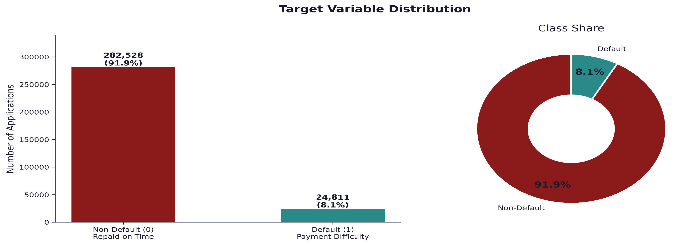
Target Distribution
Key Insight:
Portfolio is highly imbalanced
Only ~8% customers default
Most customers are good borrowers

Slide 54
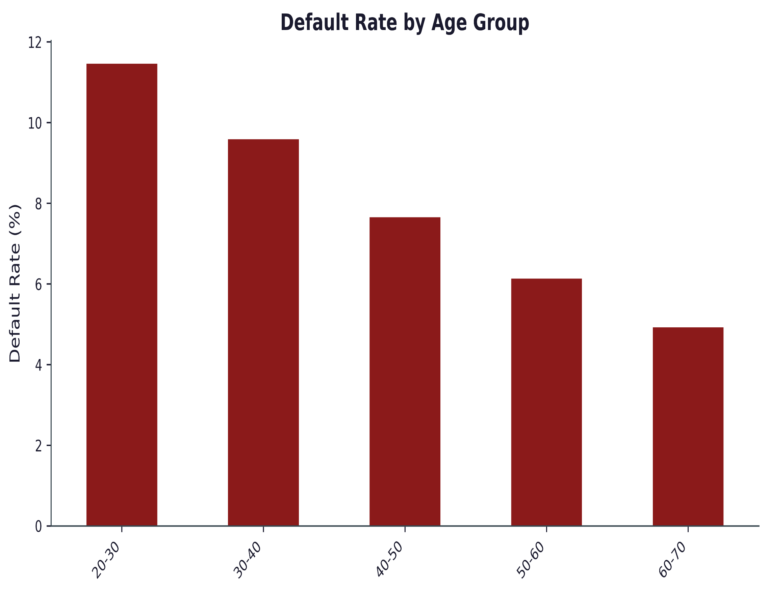
Default Rate by Age Group
Key Insight:
Default risk decreases consistently with age.
Applicants aged 20–30 have the highest default rate (~11.4%).
Applicants aged 60–70 have the lowest default rate (~4.9%).
Young borrowers are more than twice as likely to default as older borrowers.
Default rate falls from ~11.4% (20–30) to ~4.9% (60–70), a reduction of over 50%.
Age appears to be a strong predictor of credit risk.
Business Insight:
Default rates show a clear negative relationship with age. Younger applicants (20–30 years) exhibit the highest default risk, while older applicants (60–70 years) have the lowest default rates. This suggests that age is a significant factor in credit repayment behaviour and may be an important predictor in the default risk model.

Slide 55
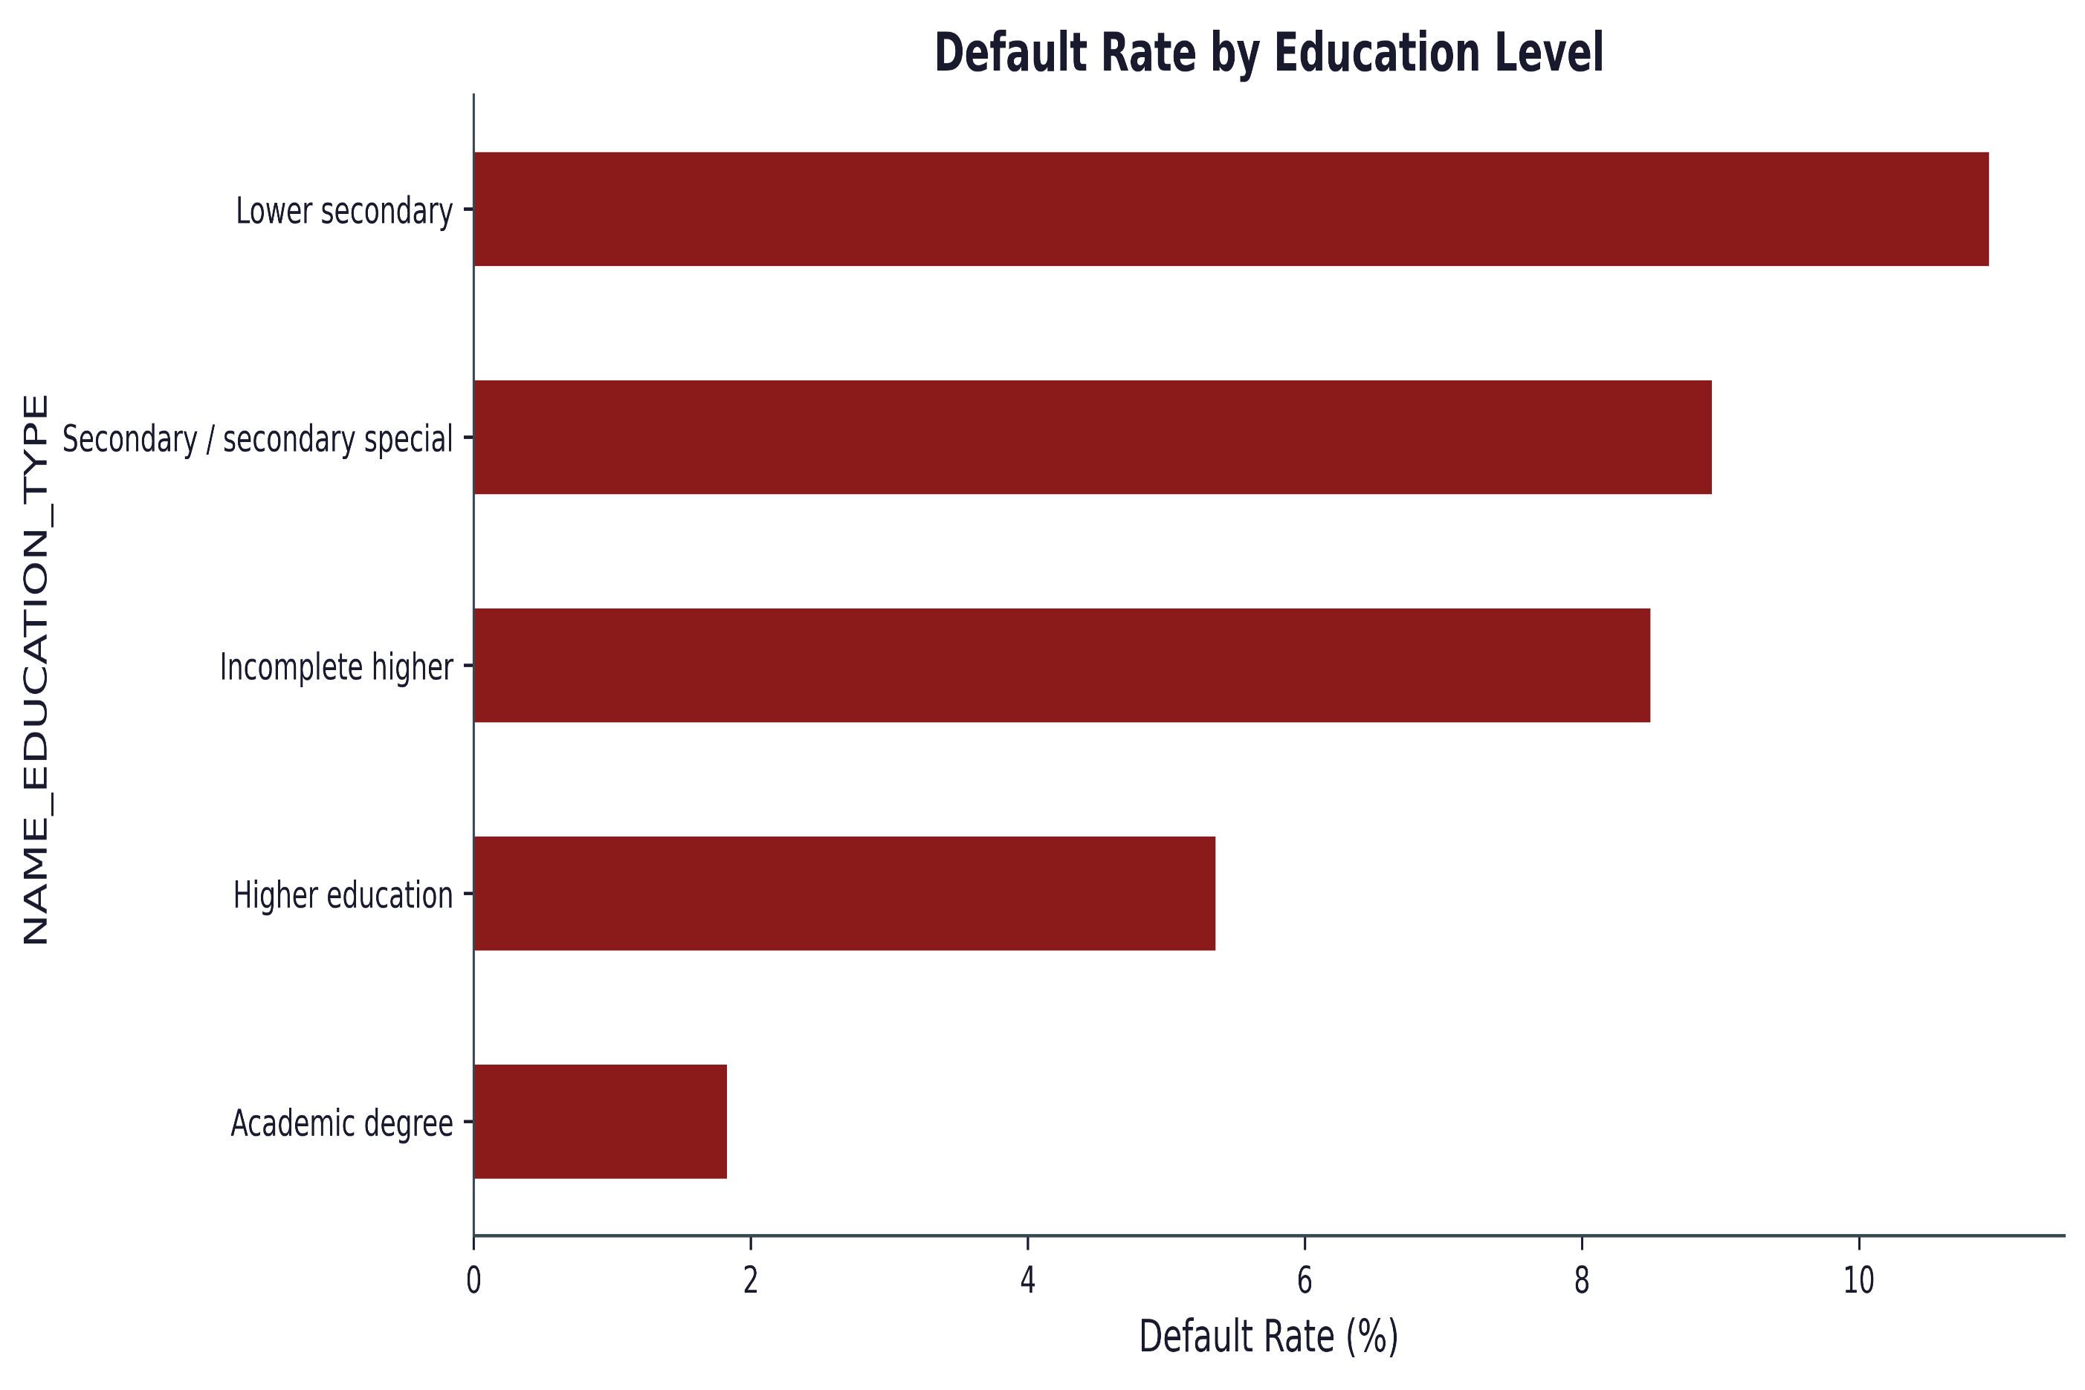
Default Rate by Education Level
Key Insight:
Default rates decline significantly as education level increases, from ~11% for Lower Secondary education to ~2% for Academic Degree holders.
Applicants with Higher Education and Academic Degrees exhibit substantially lower default risk than those with secondary-level education.
Business interpretation:
Education level is a strong credit risk indicator.
Applicants with advanced education demonstrate better repayment behaviour and can be considered lower-risk borrowers, whereas customers with lower educational attainment may require stricter underwriting and monitoring.

Slide 56
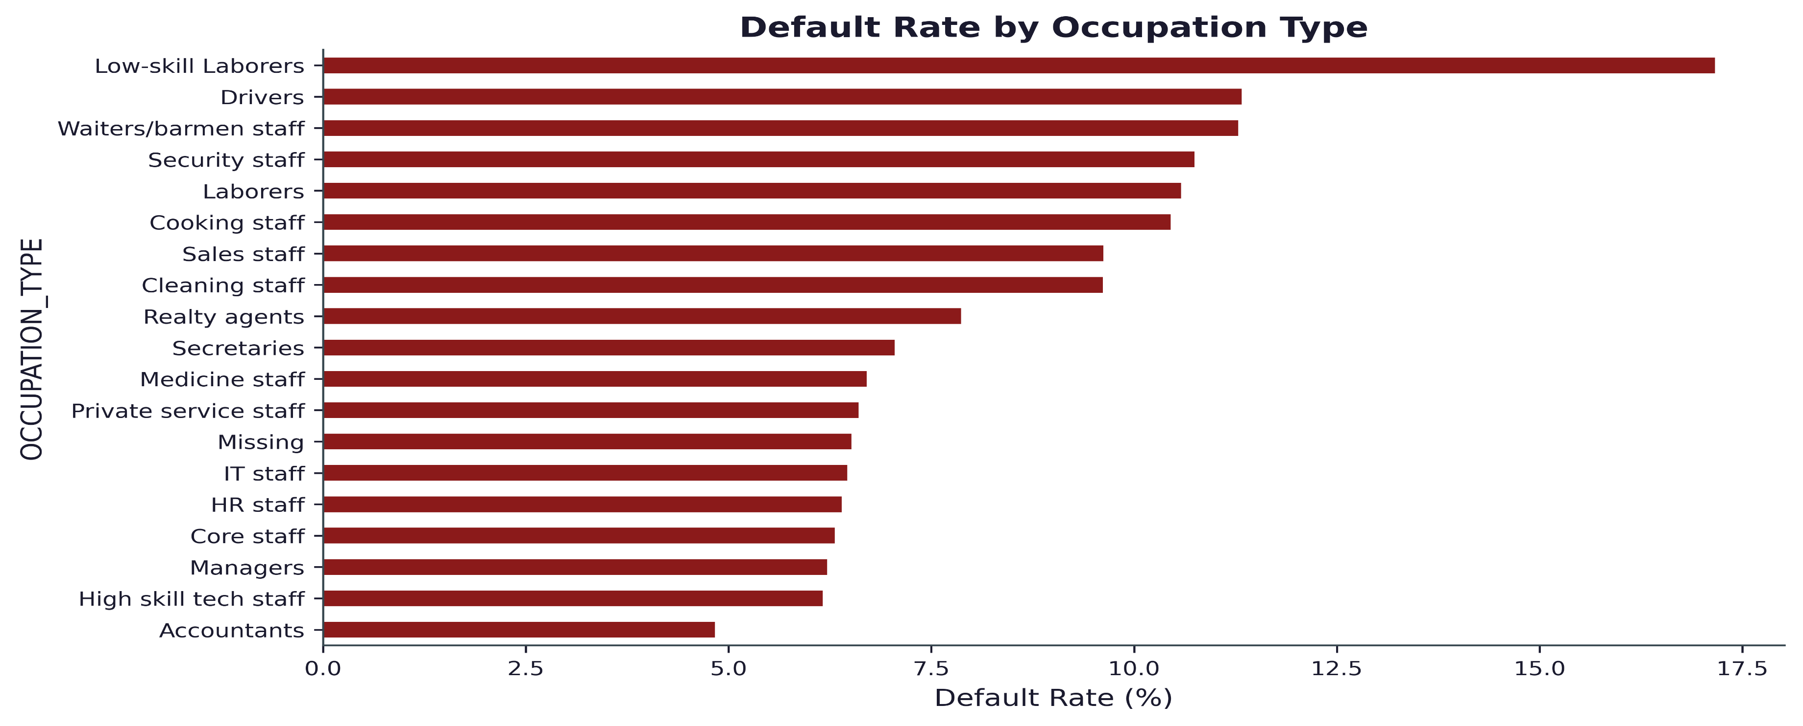
Default Rate by Occupation
Key Insight:
Occupation has a strong impact on default risk.
Low-skill labourers show the highest default rates (~17%), while accountants, managers, and high-skill technical staff exhibit the lowest risk (~5–6%).
Business interpretation:
Job stability and skill level appear closely linked to repayment behaviour.
Manual and lower-skilled occupations represent higher-risk borrower segments and may require stricter credit assessment, whereas professional and skilled occupations generally demonstrate stronger creditworthiness.

Slide 57
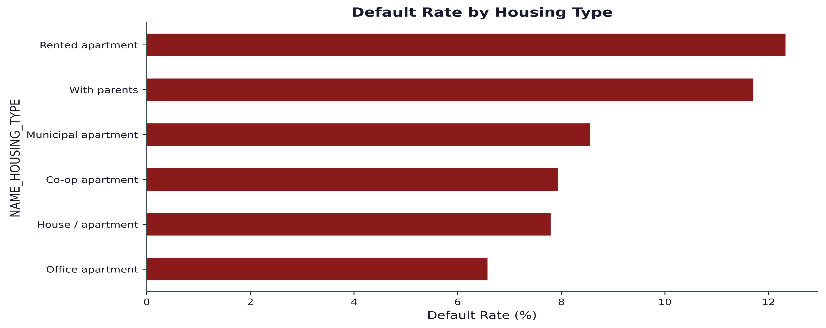
Housing Type Analysis
Key Insight:
Applicants living in rented apartments and with parents exhibit the highest default rates (~12%).
Applicants living in office apartments and owned houses/apartments show comparatively lower default rates (~6–8%).

Slide 58
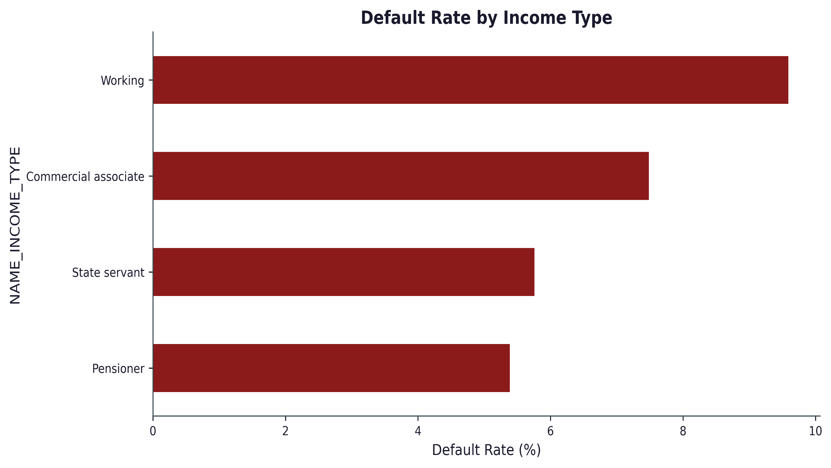
Income Type vs Default
Key Insight:
Working applicants have the highest default rate among major income groups (~9.6%).
Pensioners and State Servants show the lowest default rates (~5–6%).
Stable income sources such as pensions and government employment appear associated with better repayment behavior.
Note:"The 'Other' category exhibits the highest default rate; however, it contains only 55 applicants and therefore should not be interpreted as a reliable risk segment."

Slide 59
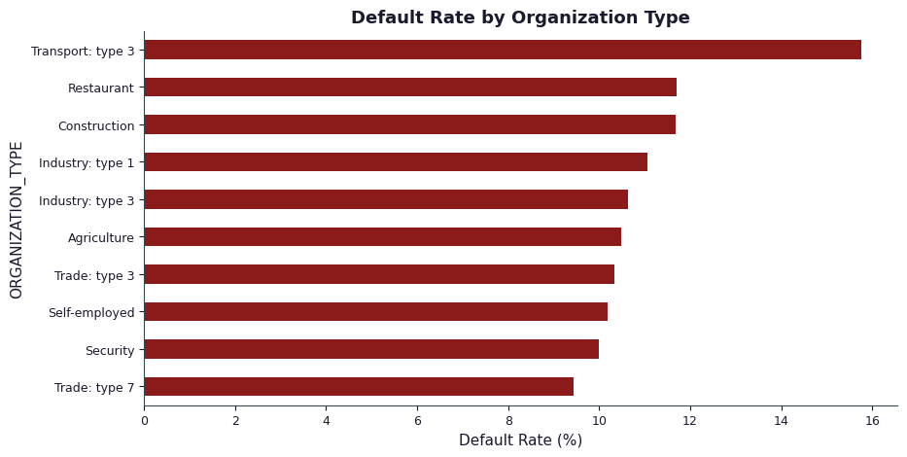
Top 10 High-Risk Organizations
Key Insight:
Transport: Type 3 exhibits the highest default rate (~15.8%), significantly above all other organization types.
Restaurant, Construction, and Industrial sectors show consistently elevated default rates (~11–12%).
Self-employed applicants also demonstrate relatively high default risk (~10.2%) despite representing a large customer segment.
Business interpretation:
Borrowers employed in transportation, construction, restaurant, and industrial sectors may face less stable income patterns, contributing to higher repayment risk.
The elevated risk among self-employed customers suggests the need for additional income verification and stricter credit assessment.
Organization type appears to be a valuable feature for segmenting applicants by credit risk and refining lending strategies.

Slide 60
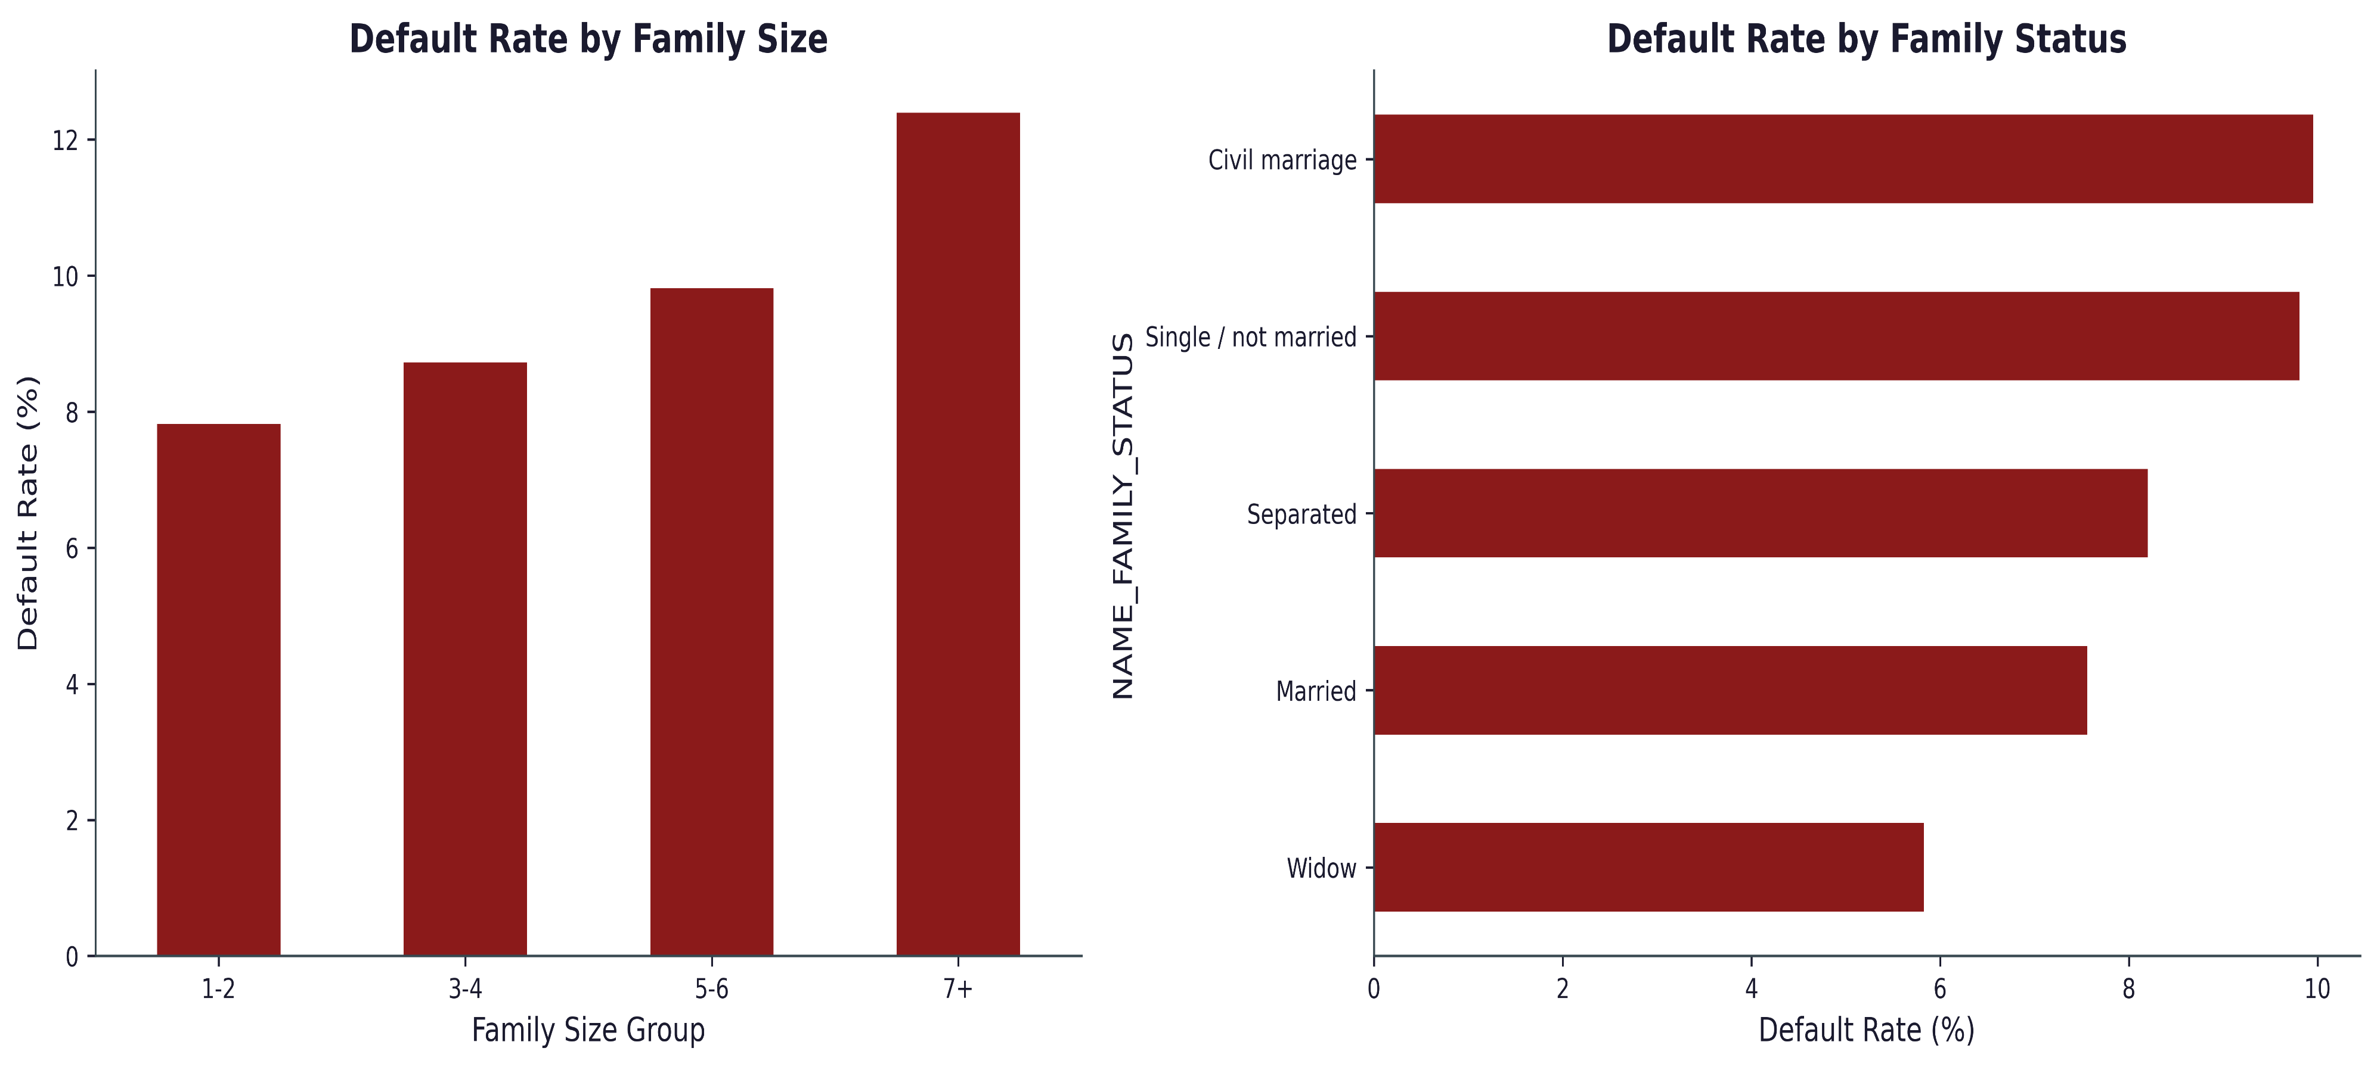
Default Rate by Family

Slide 61
Interpretation
Key Insight:
Family Size
Default risk increases with family size, rising from ~7.9% for 1–2 members to ~12.4% for households with 7+ members.
Larger households appear to face greater financial pressure, resulting in higher credit risk.
Family Status
Widowed and married applicants show the lowest default rates (~5.8% and ~7.5%).
Single/not married and civil marriage applicants exhibit the highest default rates (~10%).
This suggests household stability may be associated with stronger repayment behaviour.
Business interpretation:
Household composition is an important risk factor. Larger families and unmarried applicants demonstrate higher default propensity and may warrant closer credit assessment.
Conversely, married and widowed customers generally represent lower-risk borrower segments with better repayment performance.

Slide 62
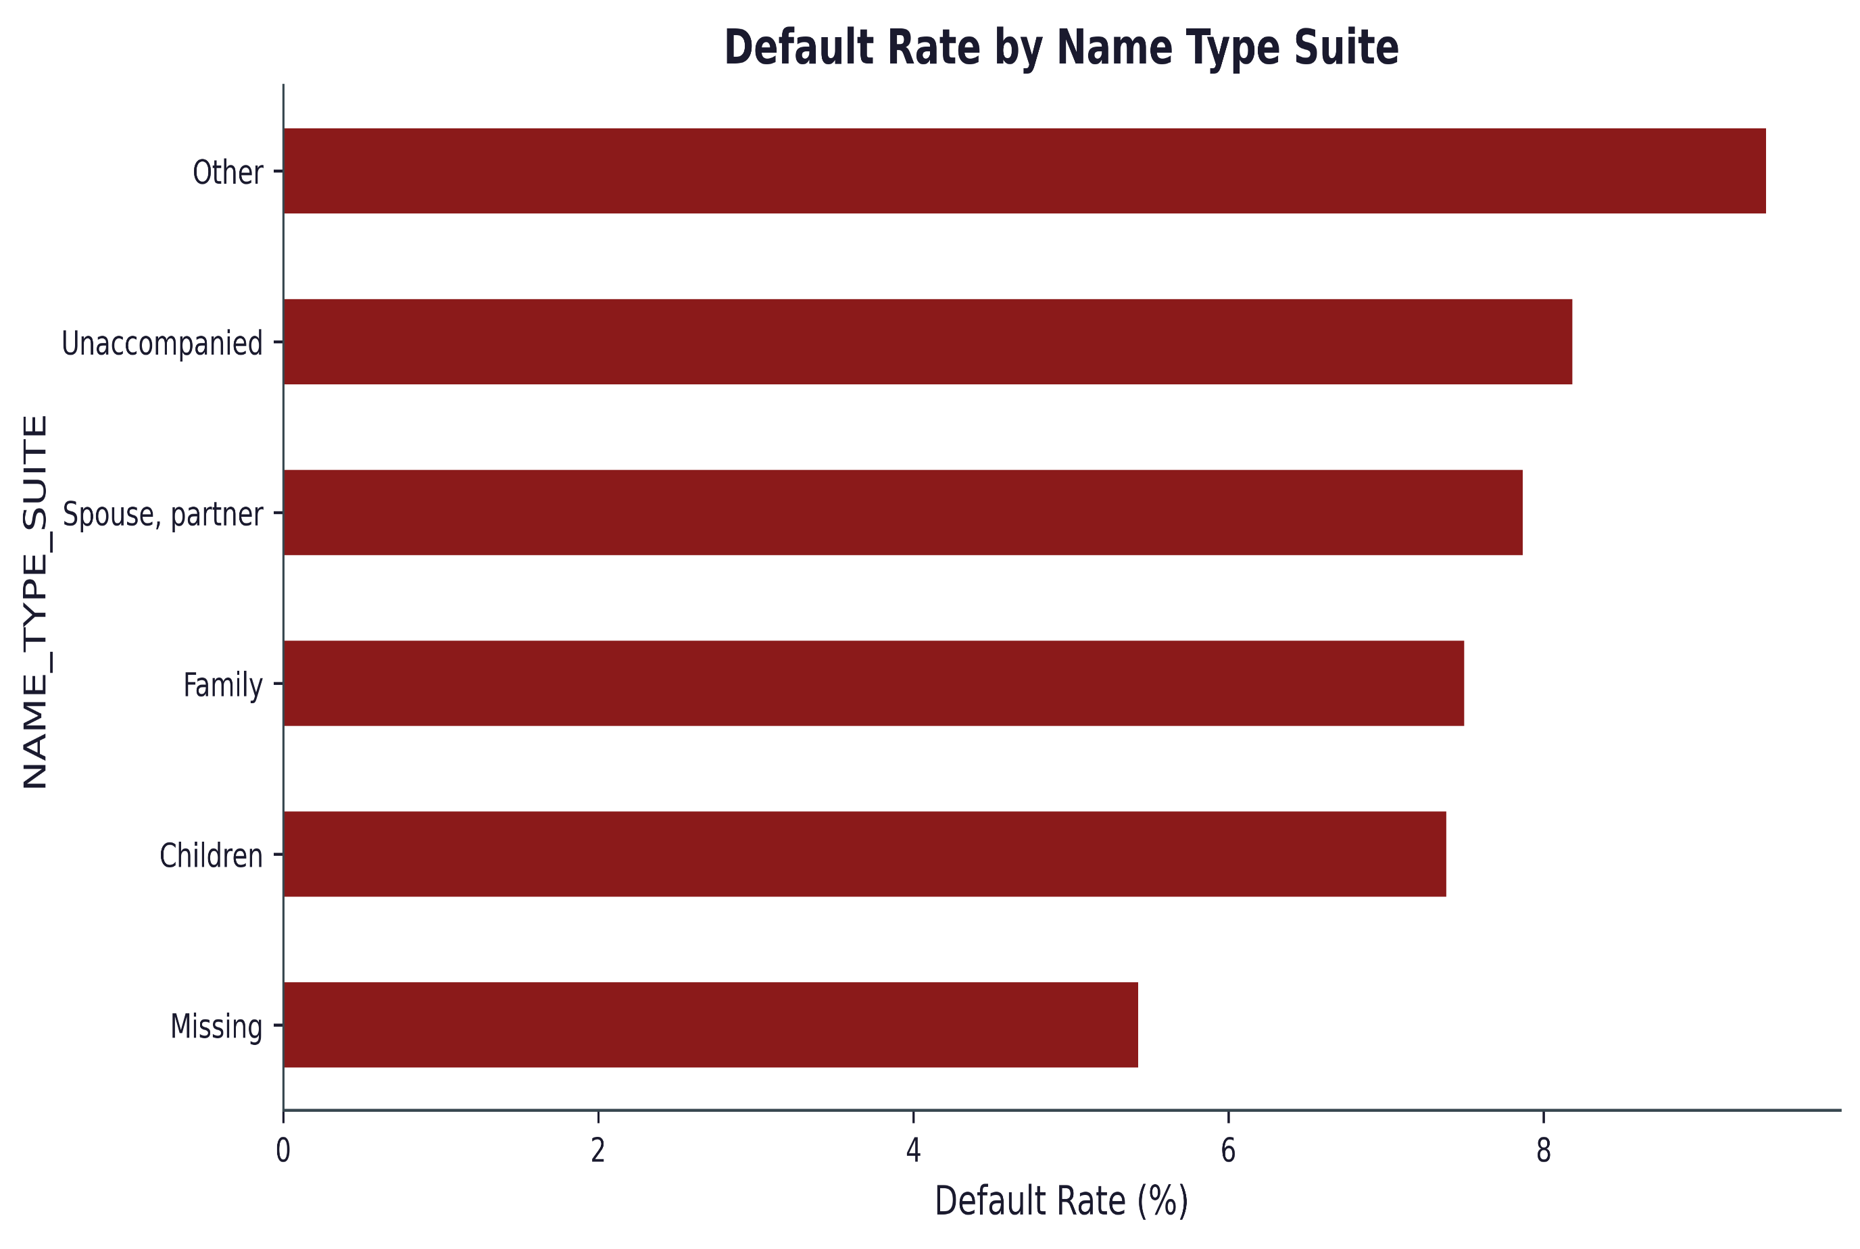
Impact of Applicant Accompaniment on Default Risk
Key Insight:
Unaccompanied applicants show higher default rates than those accompanied by family, spouse/partner, or children.
The Other category has the highest default rate but represents a small share of applicants.
Business interpretation:
Applicants accompanied by family or close relations generally demonstrate better repayment behavior.
Accompaniment type may provide additional signals about applicant stability and credit risk.

Slide 63
Demographic Risk Summary
Key Findings:
Younger applicants (20–30 years) exhibit the highest default rates (~11%), while default risk decreases steadily with age.
Education level shows a strong inverse relationship with default risk; highly educated applicants are significantly less likely to default.
Occupation and employer type influence repayment behaviour, with labor-intensive and transportation-related sectors showing elevated risk.
Applicants living in rented housing or with parents demonstrate higher default rates than homeowners.
Larger families and unmarried applicants display higher credit risk compared to married and widowed borrowers.
Business Implications:
Age, education, occupation, and family characteristics provide valuable signals for customer risk segmentation.
Younger and economically unstable customer groups may require enhanced affordability assessments and closer monitoring.
Demographic attributes can improve underwriting decisions when combined with financial and behavioural indicators..

Slide 64
Financial Risk Analysis

Slide 65
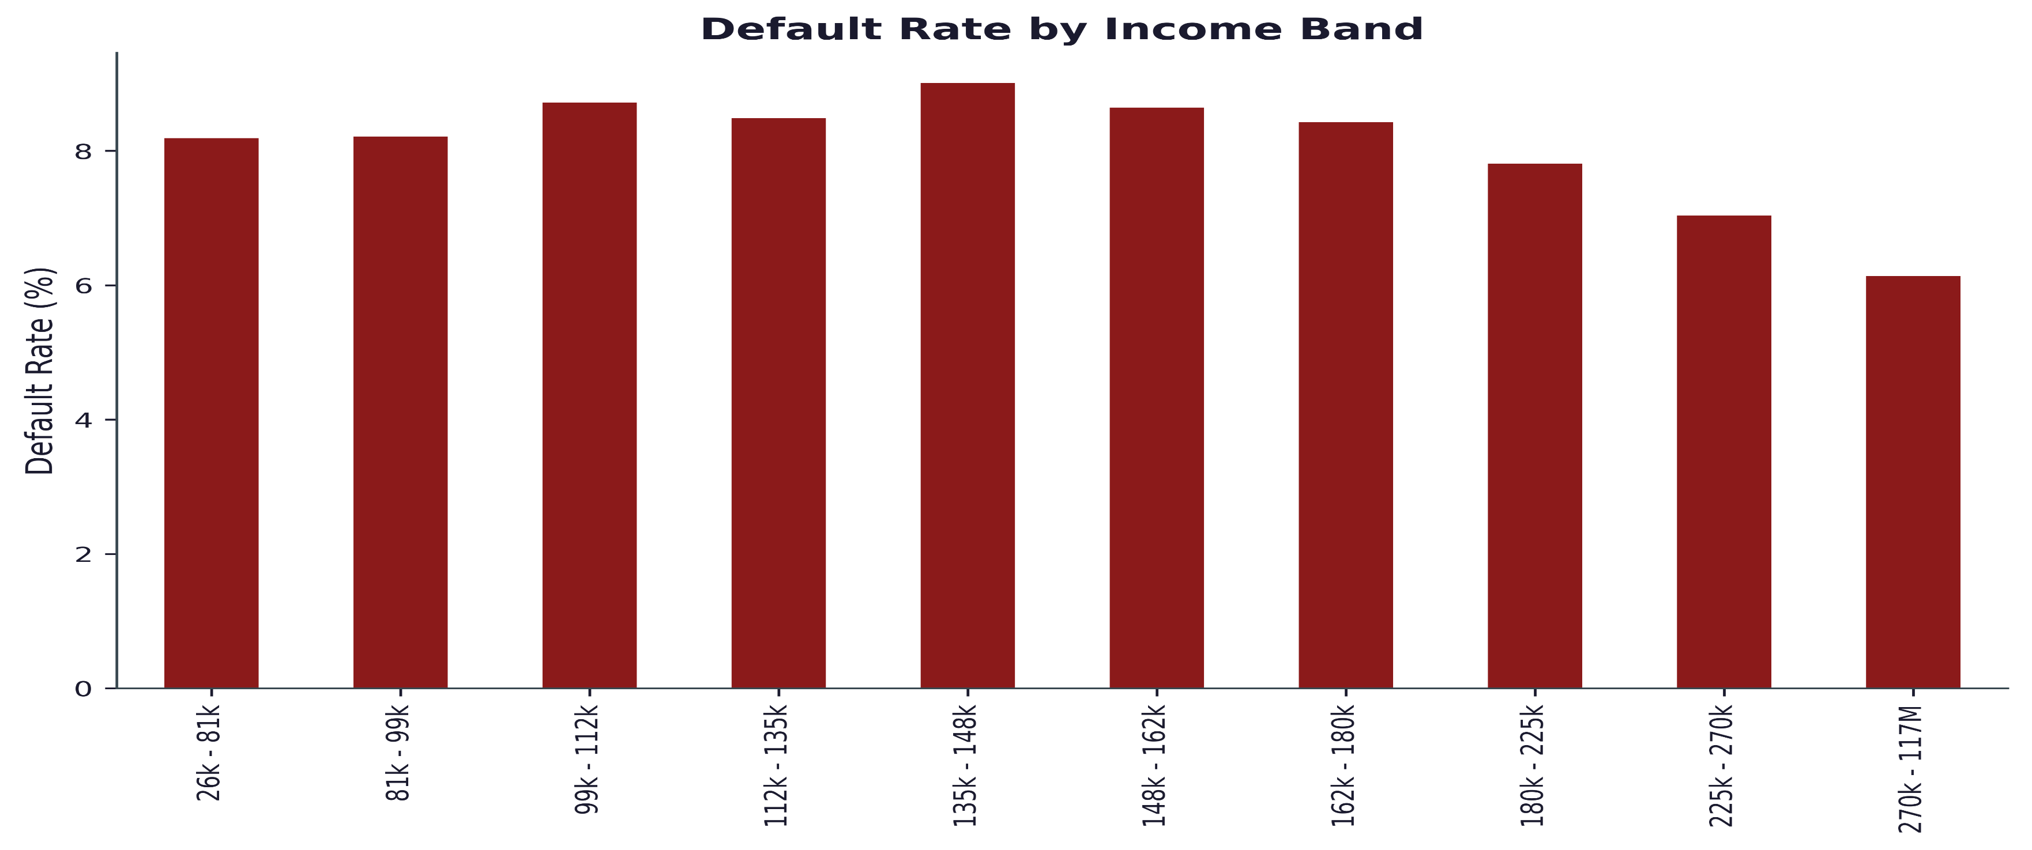
Default Rate by Income Band
Key Insight:
Default risk is highest in the middle-income segment
The ₹135K–148K income band has the highest default rate at around 9%.
Other nearby bands (₹99K–162K) also show elevated default rates (~8.5–8.8%).
Business interpretation:
Middle-income applicants may be taking on more debt relative to their repayment capacity than lower-income or very high-income groups.

Slide 66
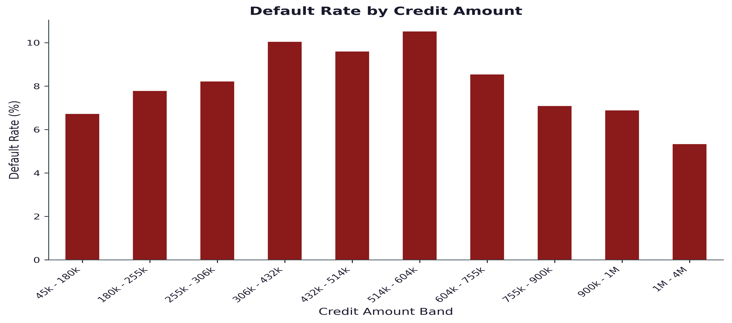
Credit Amount vs Default
Key Insight:
Default risk is highest for mid-sized loans and declines for larger credit amounts.

Slide 67
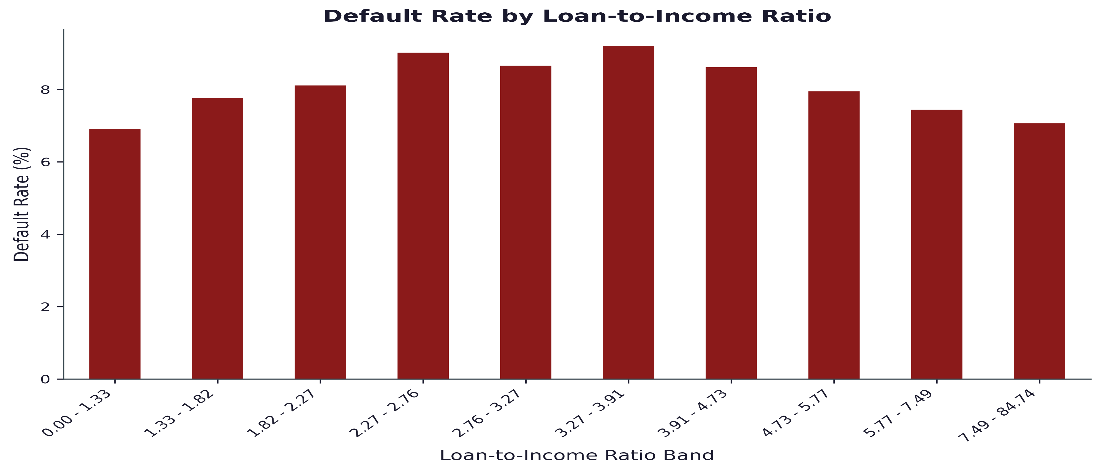
Loan to Income Ratio vs Default
Key Insight:
Default risk peaks at moderate loan-to-income levels rather than the highest borrowing ratios.

Slide 68
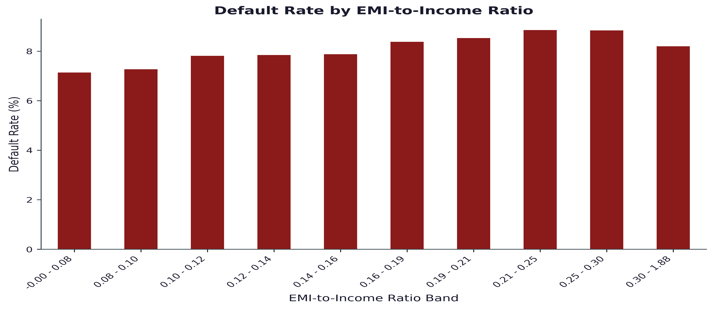
EMI to Income Ratio vs Default
Key Insight:
Higher EMI burden generally corresponds to higher default risk..

Slide 69
Financial Risk Summary
Key Findings:
Default risk peaks within middle-income segments rather than the lowest-income groups.
Mid-sized loans exhibit higher default rates than very small or very large loans.
Customers with higher EMI burdens generally demonstrate increased repayment risk.
Loan affordability measures provide meaningful insight into repayment capability.
Financial stress indicators are more informative than absolute income alone.
Business Implications:
Loan approval decisions should emphasize affordability metrics rather than income levels in isolation.
Customers with elevated repayment burdens should be monitored more closely throughout the loan lifecycle.
Debt servicing capacity remains a critical determinant of credit performance.

Slide 70
Creditworthiness Analysis

Slide 71
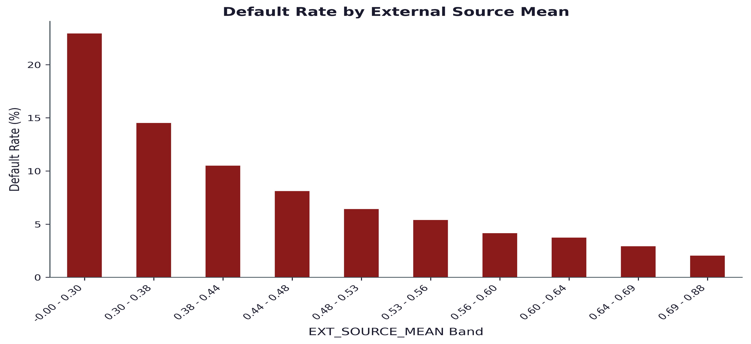
External Credit Scores Strongly Predict Default Risk
Key Insight:
Default rates decline sharply as the average external score increases.
Applicants in the lowest score band (0.00–0.30) have a default rate of approximately 23%, compared to only ~2% in the highest score band (0.69–0.88).

Slide 72
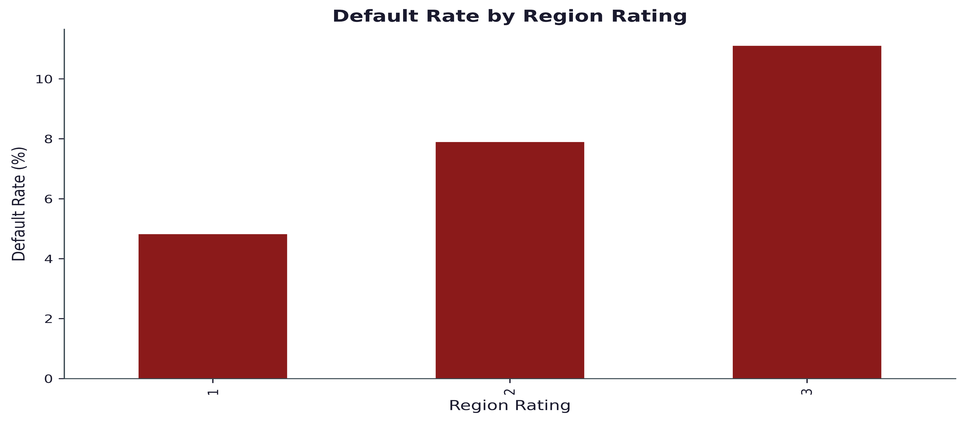
Region Rating vs Default
Key Insight:
Higher regional risk ratings are associated with substantially higher default rates.

Slide 73
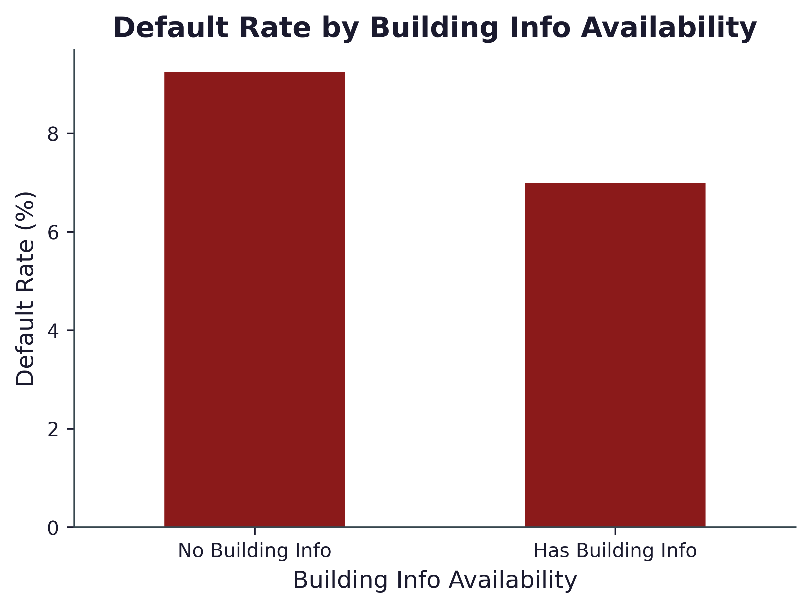
Has Building Info vs Default
Key Insight:
Missing building information is associated with elevated default risk..

Slide 74
Creditworthiness Analysis – Key Findings
Key Findings:
External credit scores (EXT_SOURCE_MEAN) are the strongest predictor of default behaviour.
Applicants with low external scores experience default rates exceeding 20%, compared with approximately 2% among high-score applicants.
Higher regional risk ratings correspond to elevated default rates.
Missing property/building information is associated with increased credit risk.
Creditworthiness indicators consistently separate low-risk and high-risk customer segments.
Business Implications:
External credit scores should remain a primary component of underwriting decisions.
Geographic and property-related information can enhance risk assessment accuracy.
Credit scoring variables provide significant predictive power for future default modelling.

Slide 75
Historical Credit Behavior

Slide 76
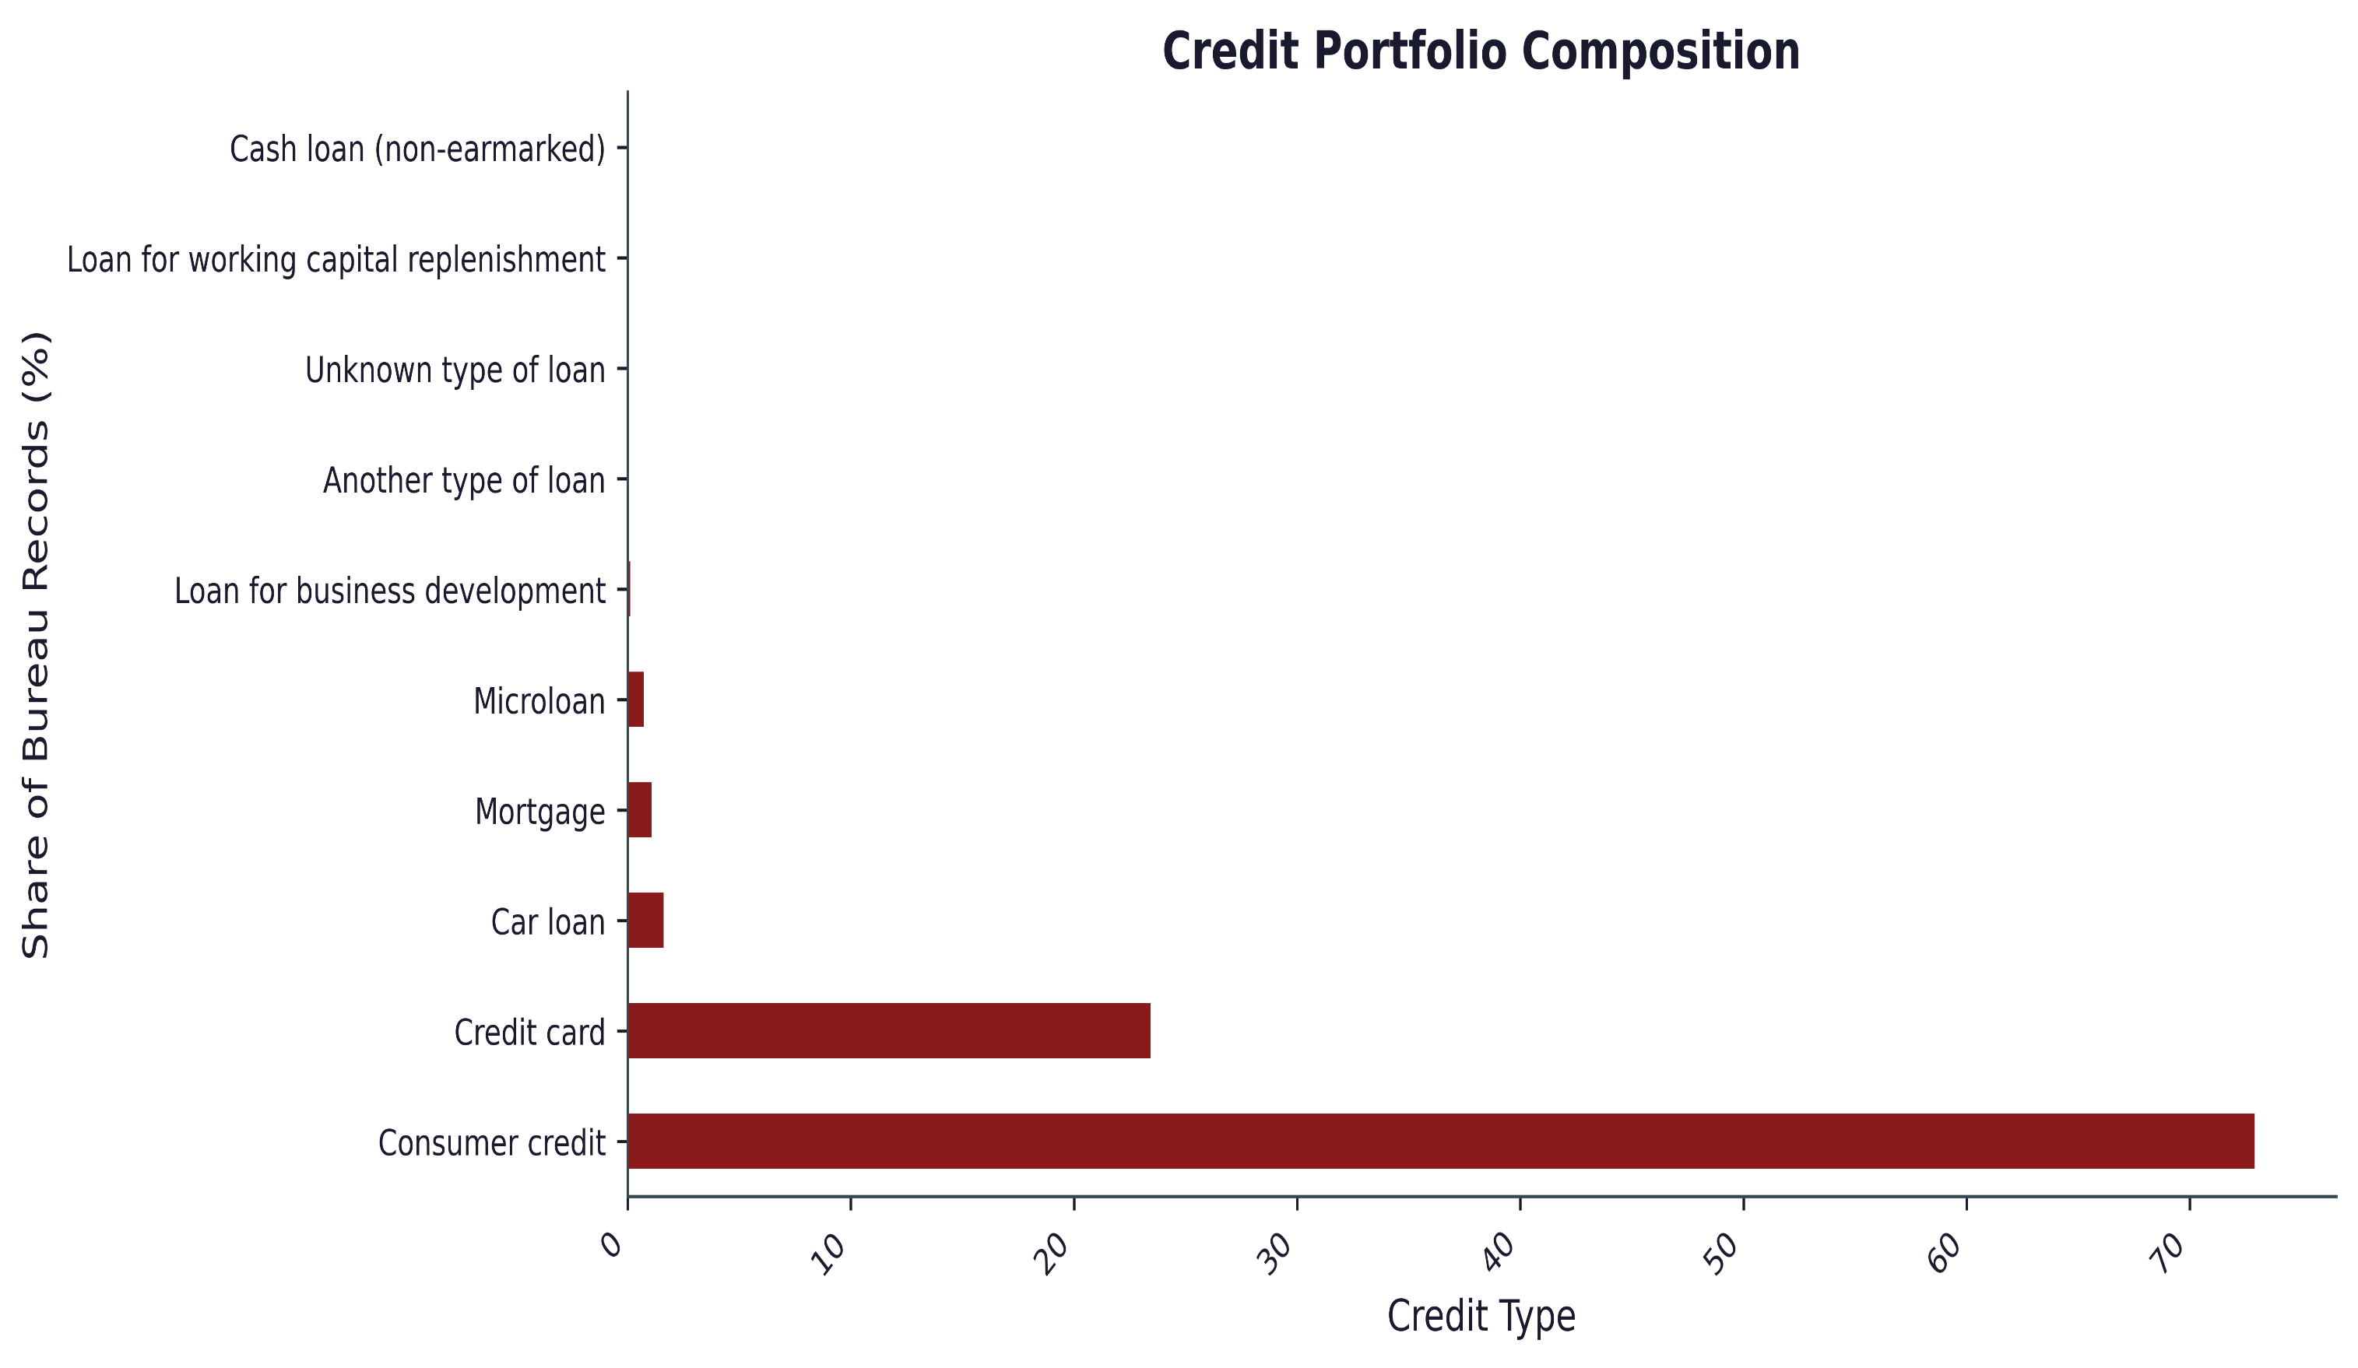
Credit Portfolio Composition
Key Insight:
Customers primarily rely on unsecured borrowing products such as consumer loans and credit cards, indicating that household borrowing is concentrated in short-to-medium-term retail lending products.
Since most customer exposure comes from consumer credit and credit cards, risk management efforts should focus heavily on these product categories.

Slide 77
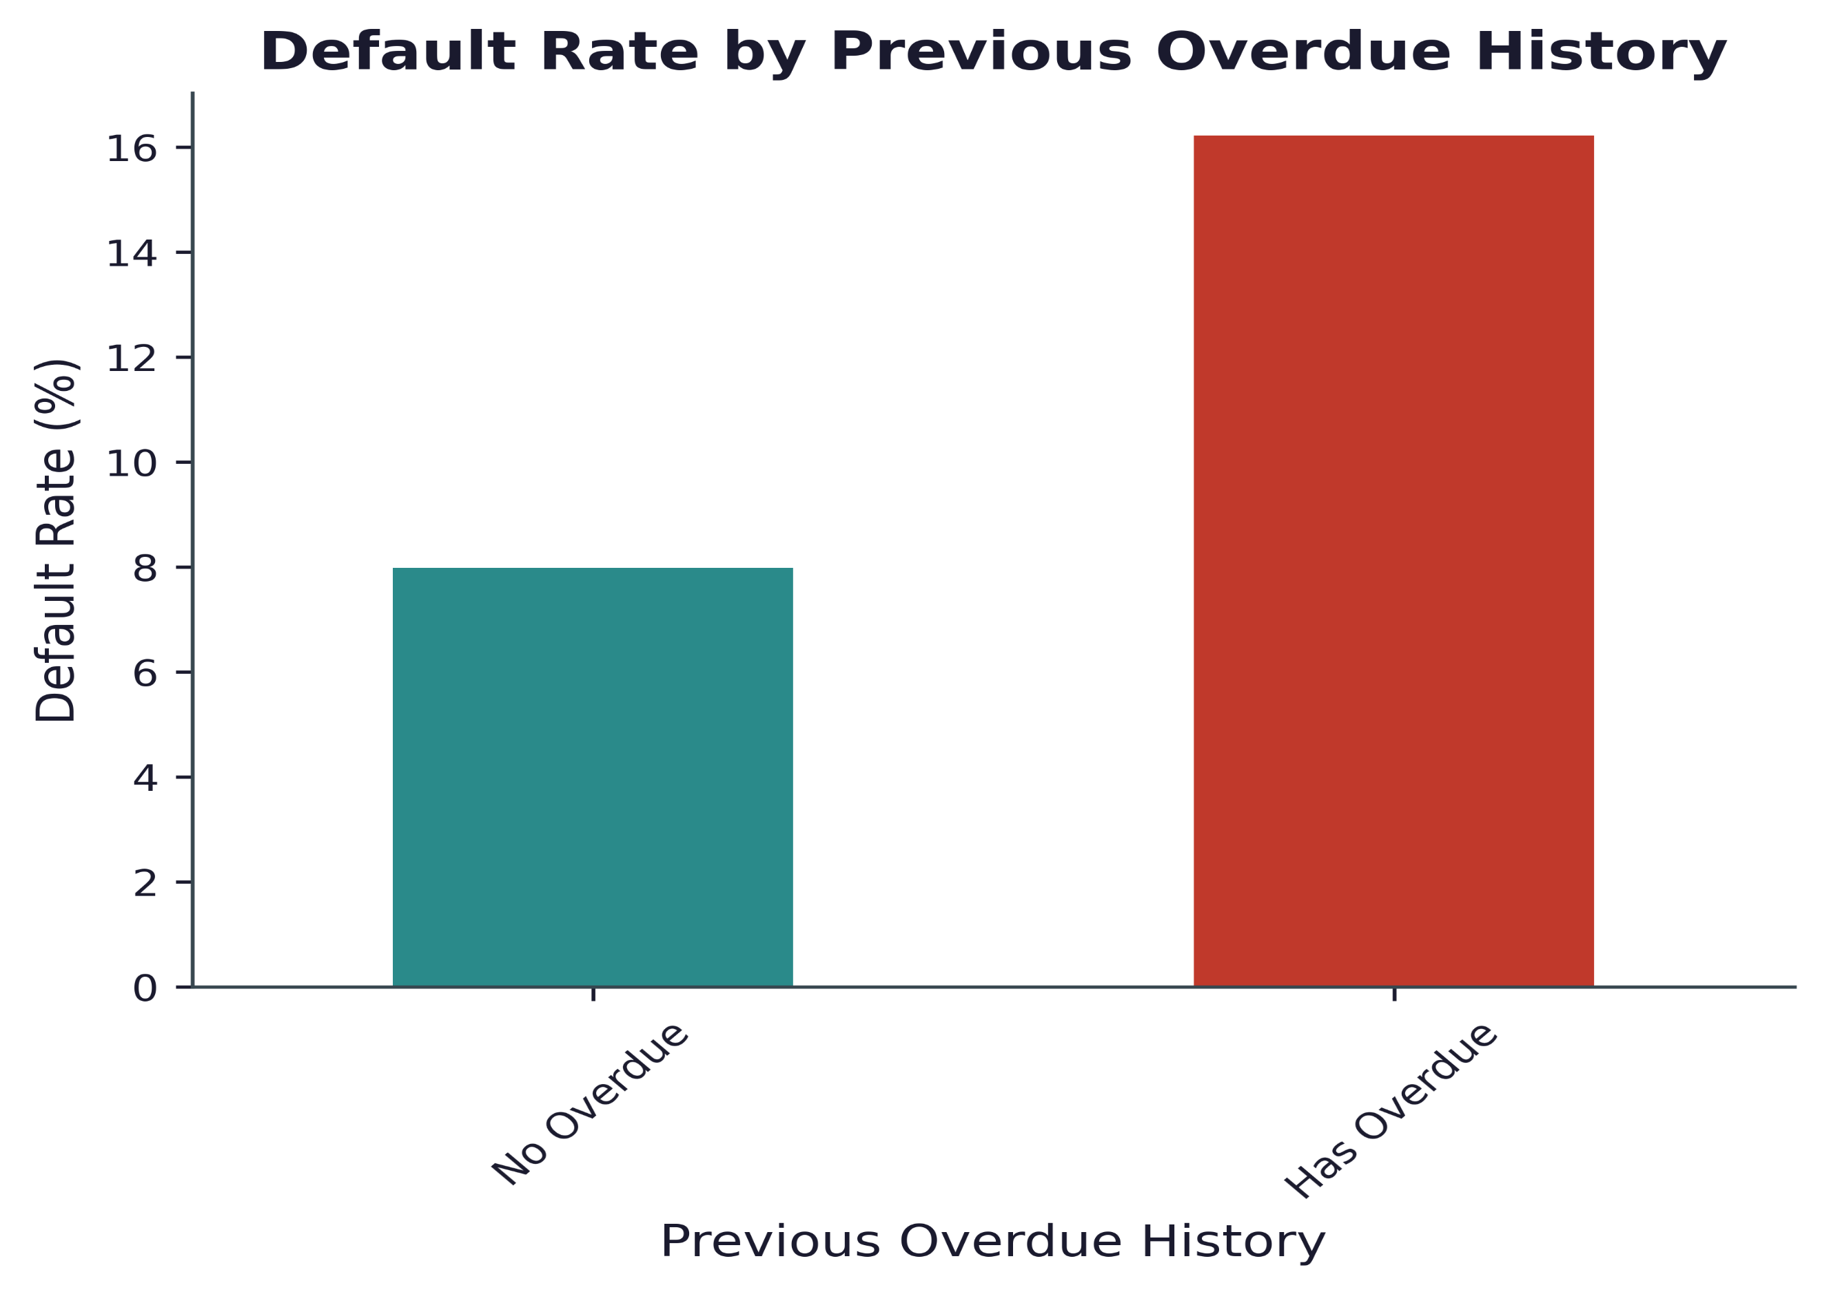
Default Rate by Previous Overdue History
Key Insight:
Customers with previous overdue obligations default at roughly twice the rate of customers with clean repayment histories.
Risk Interpretation
Past repayment behaviour strongly predicts future repayment behaviour.
Historical delinquency is one of the strongest indicators of future credit risk and should be incorporated into underwriting and monitoring strategies.

Slide 78
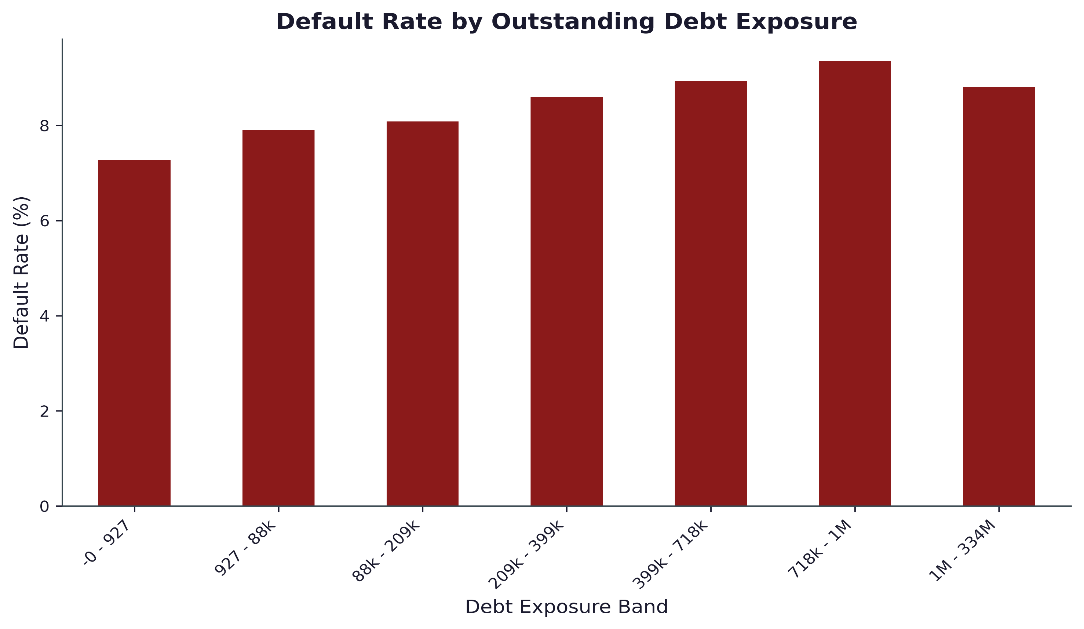
Outstanding Debt Exposure vs Default
Key Insight:
Customers carrying larger outstanding debt balances exhibit higher default propensity, suggesting increased financial leverage and repayment burden.
Risk Interpretation
Existing debt reduces financial flexibility..
Borrowers with higher external debt obligations represent a relatively higher-risk segment and warrant closer credit assessment.

Slide 79
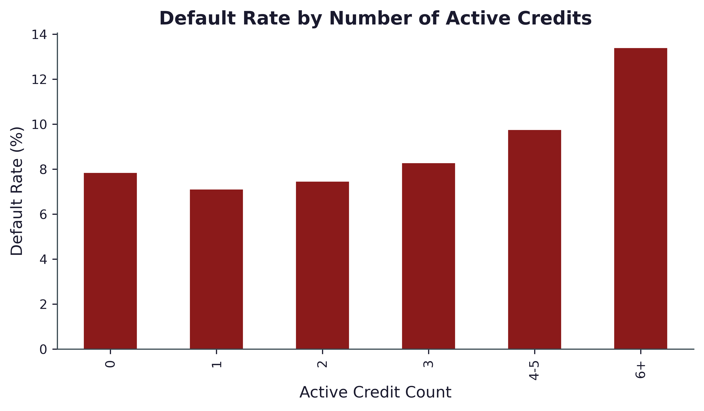
Number of Active Credit vs Default
Key Insight:
Default risk increases sharply once customers maintain multiple active credit relationships..
Risk Interpretation
Customers with many simultaneous obligations may experience repayment stress due to debt accumulation across institutions.
Credit portfolio complexity is associated with elevated default risk, particularly among customers holding six or more active credit accounts..

Slide 80
Historical Credit Behaviour– Key Findings
Key Findings:
Previous overdue history nearly doubles the probability of future default.
Customers with larger outstanding debt balances exhibit higher default rates.
Default risk increases as the number of active credit relationships grows.
Consumer loans and credit cards dominate customer borrowing activity.
Historical repayment behaviour provides strong signals regarding future credit performance.
Business Implications:
Bureau information should play a central role in credit approval and portfolio monitoring.
Customers with prior delinquency, multiple active loans, and high debt exposure warrant closer scrutiny.
Historical credit behaviour remains one of the most reliable predictors of future repayment risk.

Slide 81
Executive EDA Summary
Strongest Risk Drivers Identified:
Low EXT_SOURCE_MEAN
Previous Overdue History
Young Applicant Age
Multiple Active Credit Accounts
High Outstanding Debt Exposure.
Portfolio Characteristics:
Overall default rate remains moderate at 8.07%
Customer base is predominantly middle-aged borrowers
Lending portfolio is concentrated in consumer loans and credit cards
Repayment performance remains generally healthy despite observed risk pockets
Strategic Takeaway:
Credit risk is primarily driven by a combination of creditworthiness indicators, historical repayment behaviour, and borrower demographics. Integrating these signals into underwriting and monitoring frameworks can significantly improve portfolio quality and reduce future credit losses.

Slide 82
Conclusion and Recommendations
Key Findings | Business Recommendations
EXT_SOURCE_MEAN is the strongest predictor of default. Customers with low external scores default at ~23% vs ~2% for high-score customers. | Prioritize external credit scores during underwriting and risk segmentation.
Previous overdue history doubles default risk (≈8% → 16%). | Incorporate bureau delinquency history into approval and pricing decisions.
Younger applicants (20–30 years) exhibit the highest default rates. | Apply enhanced affordability checks for younger borrowers.
Customers with 6+ active credit accounts show significantly elevated default risk. | Monitor highly leveraged customers and limit excessive exposure.
Missing property information is associated with higher default rates. | Use property-information completeness as an additional risk signal.
Executive takeaway:
The portfolio demonstrates overall stability with an 8.07% default rate and strong repayment performance. However, external credit scores, historical delinquency, debt exposure, and borrower demographics emerge as key drivers of default risk. Incorporating these signals into underwriting and monitoring frameworks can improve loan quality and reduce future credit losses.

Slide 83
THANK YOU!

